Slide 1
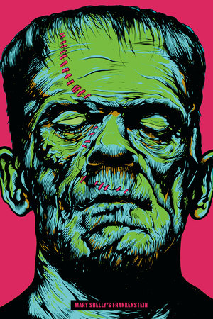
Writing in an age of Ai
Labor

Slide 2


Is writing work?

Slide 3
Amazon Fulfillment Center
Algorithms change based on if the box gets to its destination late or is broken—humans re not updated on this
  “Workers, however, are forced continually to adapt, which makes it harder to put their knowledge into action or habituate to the job” (56)
  “…how the experience of work is shifting in relation to increased surveillance, algorithmic assessment, and the modulation of time. Put another way, instead of asking whether robots will replace humans, I’m interested in how humans are increasingly treated like robots and what this means for the role of labor. Many forms of work are shrouded in the term “artificial intelligence,” hiding the fact that people are often performing rote tasks to shore up the impression that machines can do the work” (56-57)

Slide 4
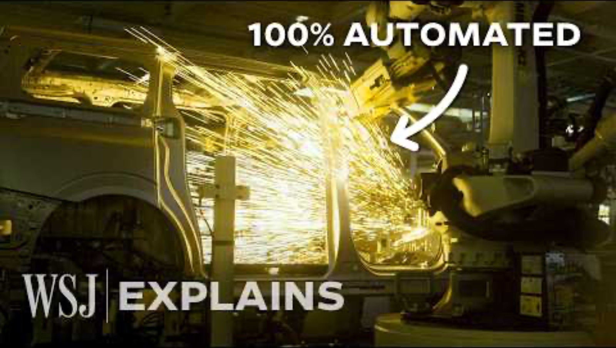
China’s dark factories

Slide 5
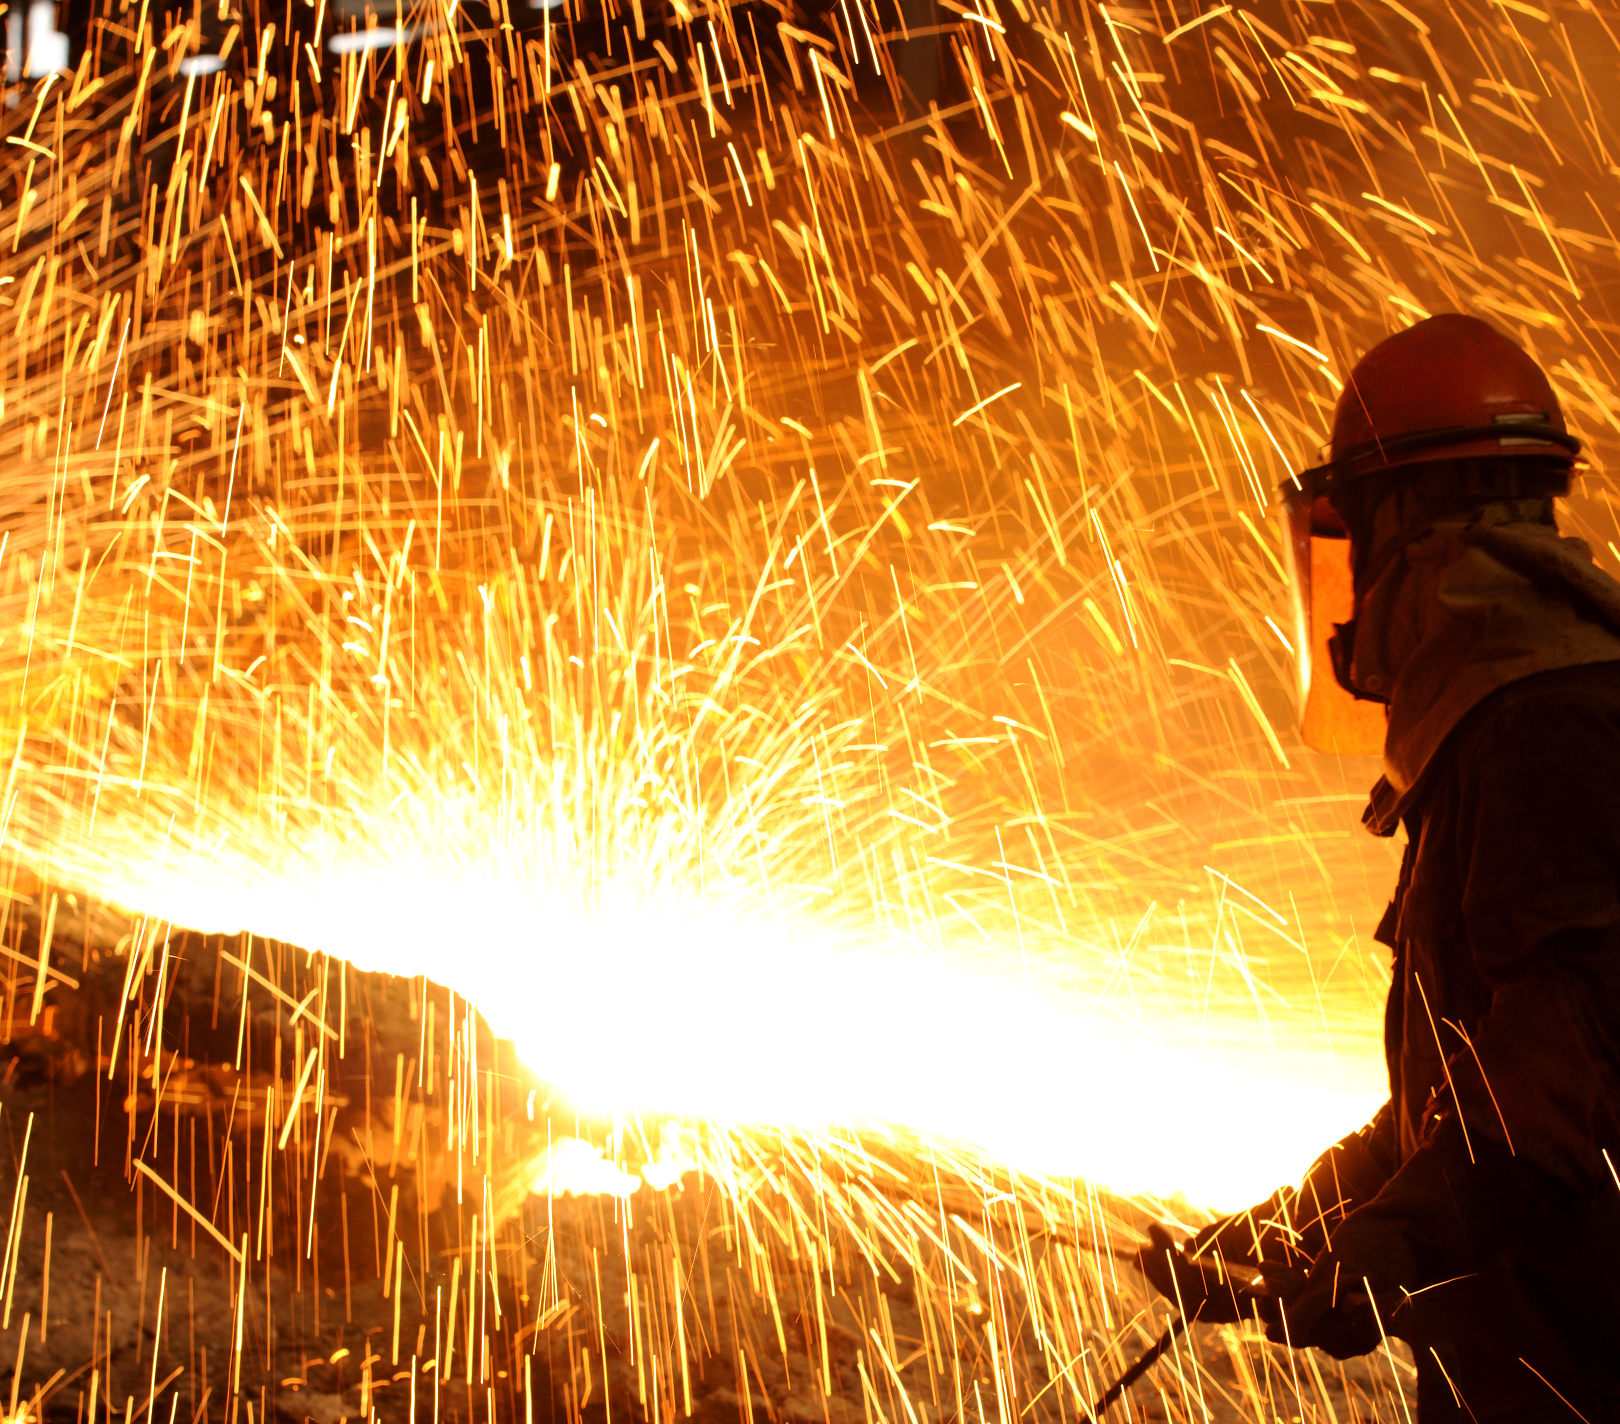
The common refrain for the expansion of AI systems and process automation is that we are living in a time of beneficial human-AI collaboration. But this collaboration is not fairly negotiated. The terms are based on a significant power asymmetry—is there ever a choice not to collaborate with algorithmic systems? When a company introduces a new AI platform, workers are rarely allowed to opt out. This is less of a collaboration than a forced engagement, where workers are expected to re-skill, keep up, and unquestioningly accept each new technical development

Slide 6
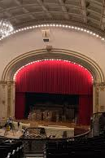
Back to the 1890’s (the gilded age!)
After many costly labor disputes (Rockefeller mines in Colorado; Carnegie sending in Pinkertons to break up the Homestead strike in the late 1800’s; railway sabotage and assassination attempts), billionaires of the Gilded Age attempted to philanthropy wash their images, donating to public projects like the Carnegie Library system in Pittsburgh, Penn Station, and other large infrastructure projects

Slide 7
Pre-History of AI
Inspection House (1780’s)
Watch closely over worker to make sure they are doing jobs correctly; need for management
Samuel + Jeremy Bentham –leads to Panopticon, Plantations
Babbage - Analytical Engine (1830’s )
Chicago Meat Market
Perfect view of factory assembly and (dis)automation
Harry Braverman; Upton Sinclair
Ford + Taylor
Assembly line, scientific management
Think: Charlie Chaplin hanging off the clock
Industrial Revolution ~Division of Labor
Craftspeople to lower skilled workers ; factory tools
Adam Smith
Able to make calculations by machine, and automate processes; for Babbage, this was the inkling of a new utopia

Slide 8
Ghost work
“The report found that a substantial number of people earned below their local minimum wage even though the majority of respondents were highly educated, often with specializations in science and technology. Likewise, those who do content moderation work—assessing violent videos, hate speech, and forms of online cruelty for deletion—are also paid poorly” (64)
  “Faking AI is an exhausting job. The workers at x.ai were sometimes putting in fourteen-hour shifts of annotating emails in order to sustain the illusion that the service was automated and functioning 24/7. They couldn’t leave at the end of the night until the queues of emails were finished” (65)

Slide 9
Potemkin AI
“We could think of this as a kind of Potemkin AI—little more than facades, designed to demonstrate to investors and a credulous media what an automated system would look like while actually relying on human labor in the background. In a charitable reading, these facades are an illustration of what the system might be capable of when fully realized, or a “minimum viable product” designed to demonstrate a concept. In a less charitable reading, Potemkin AI systems are a form of deception perpetrated by technology vendors eager to stake a claim in the lucrative tech space” (65)

Slide 10

The Theranos Fraud
Notice Elizabeth Holmes talk about this machine when it was legally proven they knew the machine never worked

Slide 11

The Theranos Fraud
Notice Elizabeth Holmes talk about this machine when it was legally proven they knew the machine never worked

Slide 12
Fauxtomation
“The true labor costs of AI are being consistently downplayed and glossed over, but the forces driving this performance run deeper than merely marketing trickery. It is part of a tradition of exploitation and deskilling, where people must do more tedious and repetitive work to back-fill for automated systems, for a result that may be less effective or reliable than what it replaced. But this approach can scale—producing cost reductions and profit increases while obscuring how much it depends on remote workers being paid subsistence wages and off-loading additional tasks of maintenance or error-checking to consumers” (66)

Slide 13
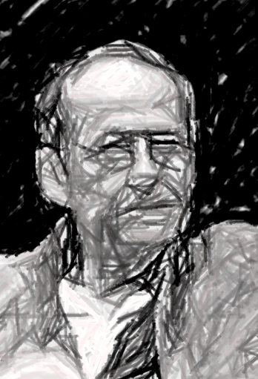
Proletarianization
Bernard Stiegler’s theory that AI is part of a broader history of automation, which de-skills workers and takes away the knoweldge of how to do, which in turn takes away knowledge of how to live
He suggests we need better educational institutions that protect that passing down of how to live, so that future generations don’t turn to violent outbursts when they are deprived of symbol making (what he calls ‘symbolic misery’)

Slide 14
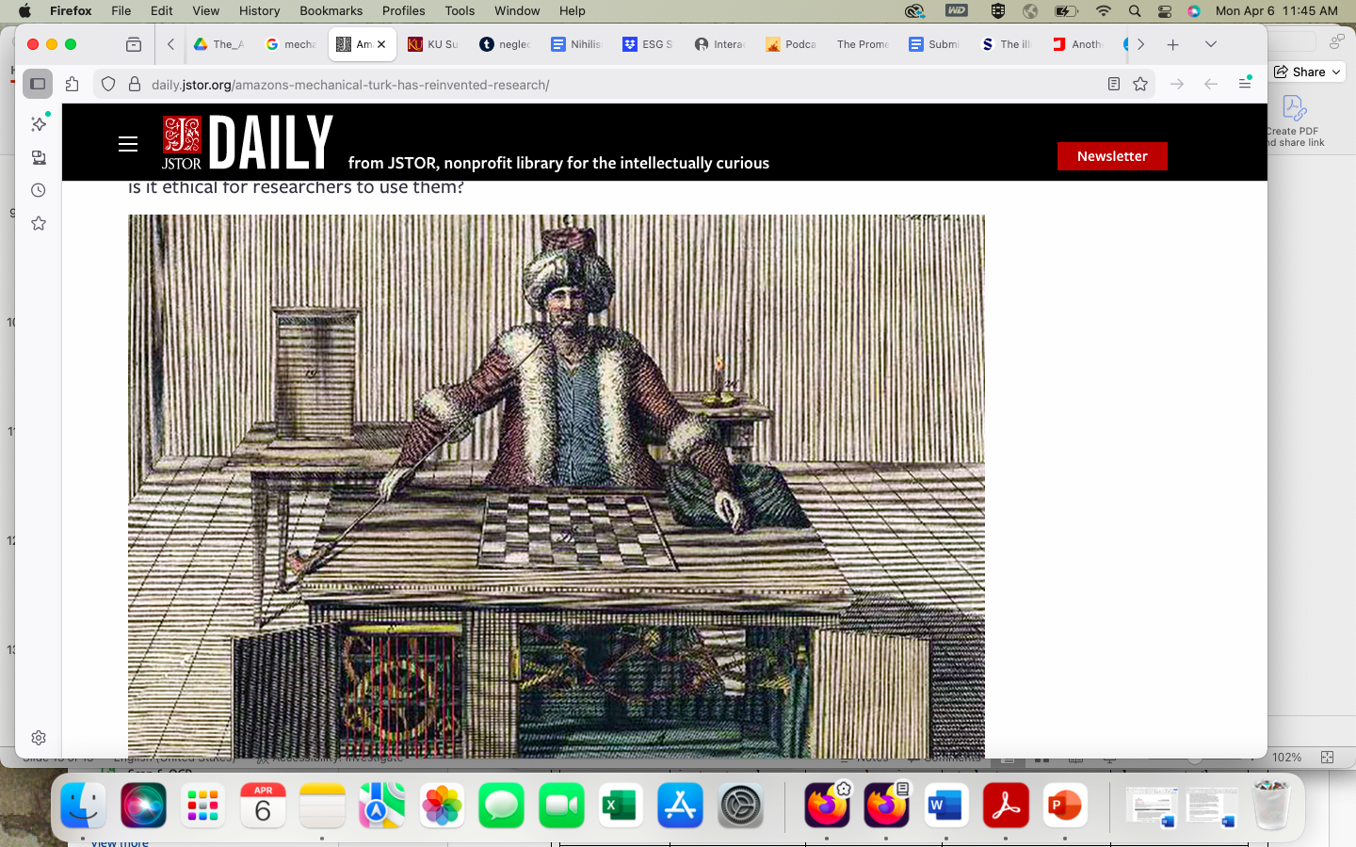
Mechanical Turks

Slide 15
Lords of time
“Controlling time becomes another way to manage bodies. In service and fast-food industries, time is measured down to the second. Assembly line workers cooking burgers at McDonald’s are assessed for meeting such targets as five seconds to process screen-based orders, twenty-two seconds to assemble a sandwich, and fourteen seconds to wrap the food. Strict adherence to the clock removes margin for error from the system. The slightest delay (a customer taking too long to order, a coffee machine failing, an employee calling in sick) can result in a cascading ripple of delays, warning sounds, and management notifications” (74-75)

Slide 16
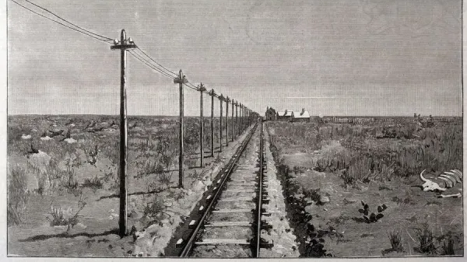
From arbitrage to futures

Slide 17
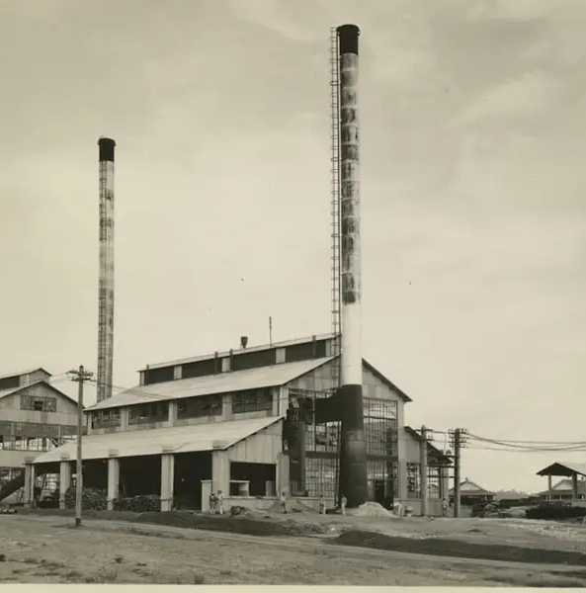
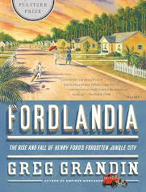
Fordlandia!
Henry Ford bought some land in the Amazon so that he would have rubber for his car in a vertically integrated supply chain.
He also imposed specific working conditions he thought were good for ‘the soul’—no caffeine or alcohol; mandatory working hours of 8-5 (in the Amazon, workers wanted to work very early, siesta, and very late, due to the heat); and mandatory line dancing to country music.
Of course, this led to riots and burning the place down—twice.

Slide 18
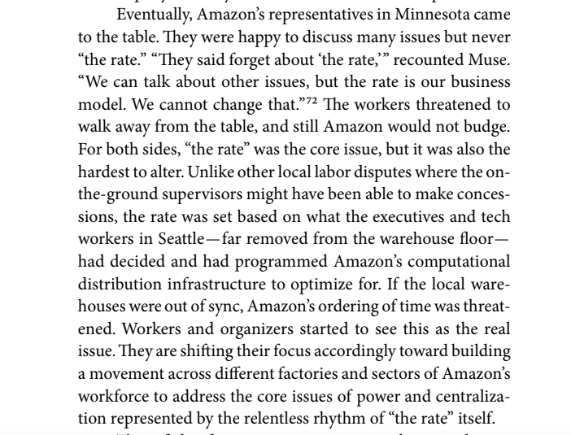
The rate
“Controlling time—whether via the clocks for churches, trains, or data centers—has always been a function of controlling the political order” (70)

Slide 19



2007 writers strike
The 2007 Writer’s Strike left networks in search of cheap and exploitable labor—enter reality TV
Reality TV explodes after the strike, where production costs drop and producers don’t have to deal with savvy showrunners or unionized actors—you want to be famous, do this ridiculous thing
Good thing nothing bad ever came of this medium…

Slide 20
First labor organization to take on AI
“Talent lawyer Darren Trattner notes that “a writer is defined in the basic agreement as a ‘person,’” and the WGA could theoretically forbid AI from working on guild projects — but functionally it might not be possible”
“As for writers, there may be room for compromise between letting AI generate entire projects and banning it, as Trattner notes: “When using AI, there is an ‘input’ and an ‘output.’ The input could be: ‘Write a screenplay about a boy who meets a girl, they break up and get back together. Turn that into a romantic comedy.’ The output is what AI generates from the input. If we cannot prevent AI, maybe the input always must be done by a WGA member” (Cullins, Kilkenny)

Slide 21
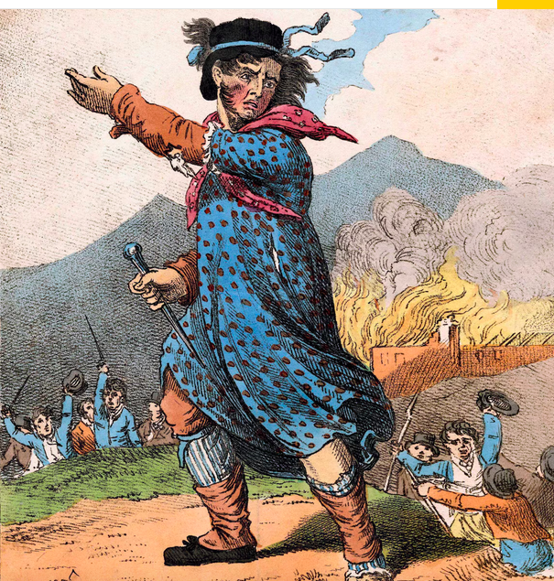
King Ludd and smashing thing at work
In the first year Luddites smashed around 10,000 £ of weaving machinery
Luddites attempted to negotiate deals with manufacturers, wrote threatening letters, and made public statements; in return, the British gov’t sent troops to (Brutally) disband them, and formed informal spy networks to inform on their efforts
Machine breaking became a capital offense!

Slide 22

How to lose the PR War
“The crackdown on the movement also helped the word “Luddite” take on a new meaning. “The state actively sought to cast them in a negative light to make them look foolish—and, because they lost, and because the state had influence over many of the nation’s newspapers, the derogatory meaning stuck,” Merchant explains” (Djangi, 2025)

Slide 23
Napoleonic wars
From 1793 to 1815, these wars caused food shortages and unemployment
There’s also the ‘Year Without a Summer’ on the horizon, which only made this worse! (and is the vibe under which Frankenstein is written)
If you think of a Dickens novel, where there’s dirty children cleaning chimney sweeps and a literal scrooge, most of that is emanating from the disasters of automation, war, and consolidation of wealth
Do we see labor in Frankenstein outside of Justine?

Slide 24

AI is inevitable

