Slide 1

Writing for Public Relations
PRWR 216
Spring 2026

Slide 2
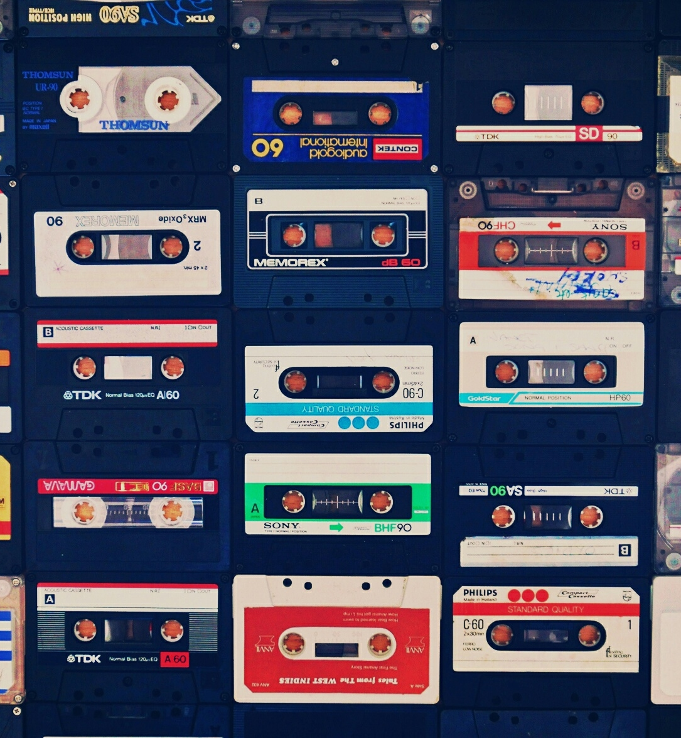
Ed Zitron on Pitching
After securing coverage for an e-reader in the NYT WSJ, WIRED, and 15 other outlets: “…all I relaly did was talk like a normal person and mention the things that I’d give a shit about if I were the one reading an email” (2013)

Slide 3
Three Rules
It’s under 200 words
It must be direct and free of jargon or fluff
It’s written, not copy-pasted. Write each pitch individually, for each person, each time.

Slide 4
BE Human!
According to our survey of over 3,000 journalists, a typical reporter receives up to 50 pitches per week (Cision)
Cold Calls work—[ick up the phone, get on the line with someone. Don’t script, get right to the point

Slide 5
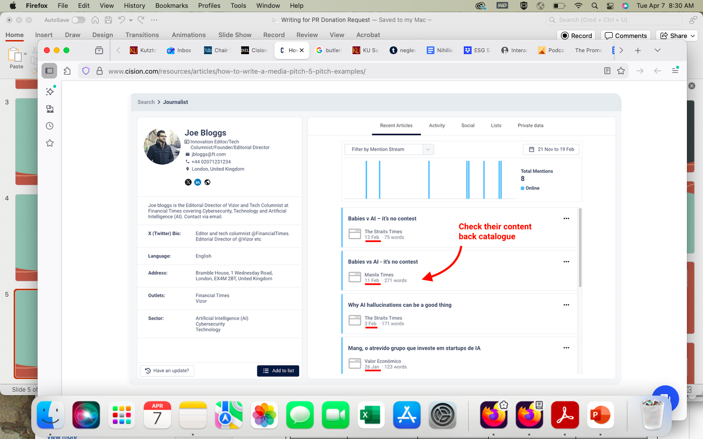
According to our survey of over 3,000 journalists, a typical reporter receives up to 50 pitches per week (Cision)

Slide 6
Parallel Journalism
Follow brand-relevant journalists on social media to get updates on their content, opinions, and beat
Set up alerts and Twitter/X lists to take your research further
Subscribe to their Substacks, newsletters, or Discords – many journalists will be across these platforms, so join them to stay in-the-loop
Mirror the topics, language, formats, and emotionality of the content they produce and share
Assess their best pieces of content, and use them as the basis for your next media pitch idea
Monitor popular journalist request hashtags to find new pitching opportunities

Slide 7
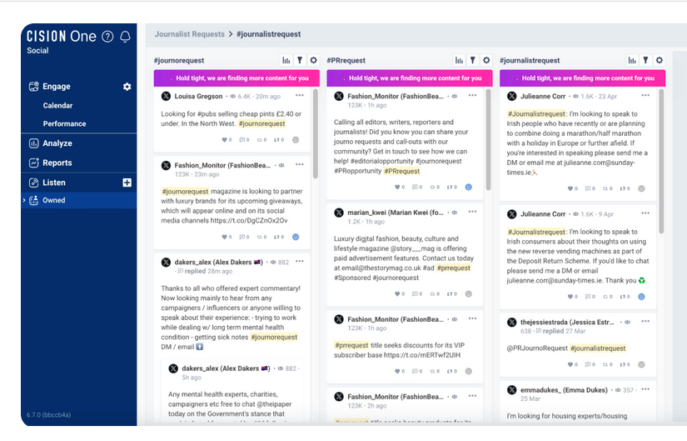
Media Lists & CRM’s
It is impossible to just be culturally relevant (for long) and know who to contact. Most sales org’s have Customer Relationship Management tools (CRM’s) which track potential clients or buyers.
In PR, we have Cision, MuckRack, and others, which also track ‘sales’ (media impresisons)

Slide 8

Who to Pitch?
By coverage potential: Prioritize those who are most likely to cover your story
By publication: Send to journalists at major publications first, then work your way down to the niche
By geography: Batch your pitch sends based on time zone and location

Slide 9
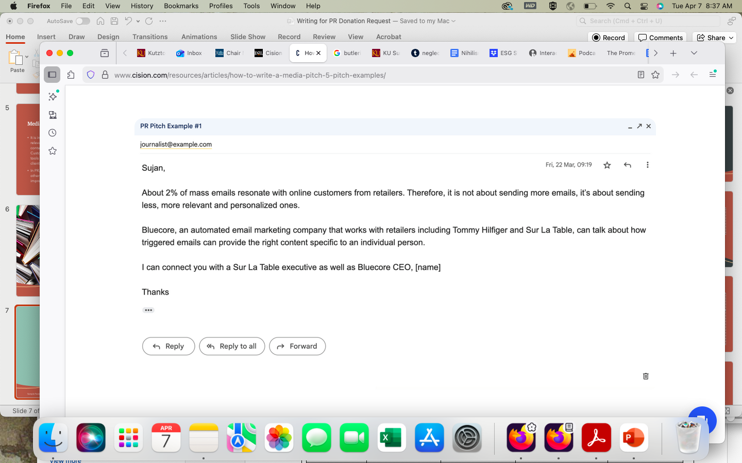
Pitch Letter One

Slide 10
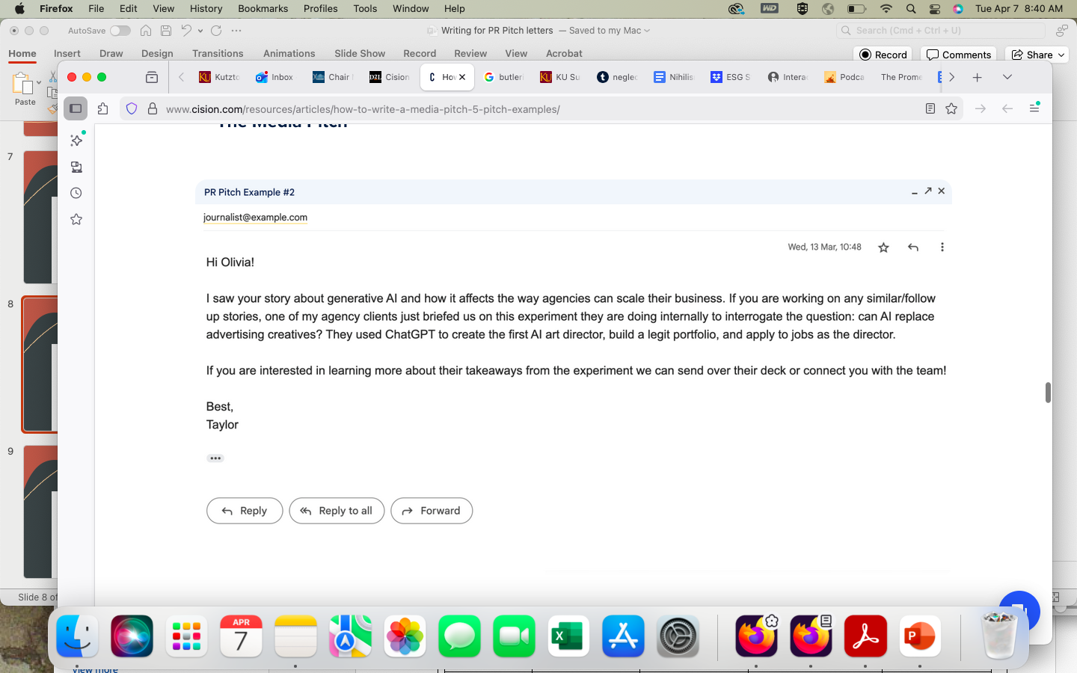
Pitch Letter Two

Slide 11
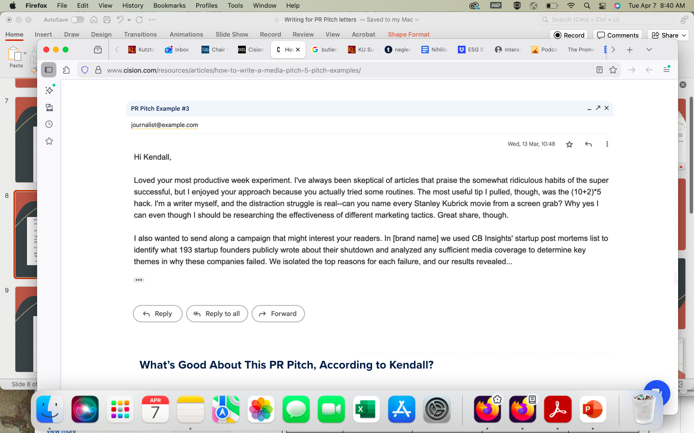
Pitch Letter Three

Slide 12
Pitch Letter Templates
I haven’t seen one that is not an email in a looongggg time. Email formatting works.
Headline should encompass as much of the story as possible
Ideally, try not to let reporters think this is a transactional deal—you need some investment in them or the product or service

