Slide 1

Writing for the Workplace
Dr. Robert Foschia
FA’ 23

Slide 2

On-the-spot Interviewing
A man pushed his car to a hotel and lost his fortune. What happened?

Slide 3
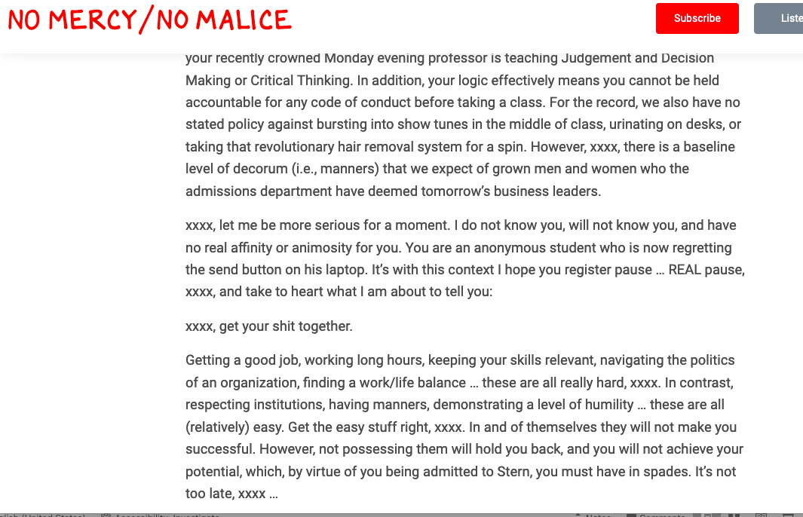
Our Old Friend Prof G…
Get the Easy Stuff Right

Slide 4
Perspective from a search committee
You want a conversation—not robotically answering biggest weakness, etc, but engaging with the committee and giving examples
Rapport, rapport, rapport
as unfair as it is, candidates who are over-confident (in my experience) tend to do better than those who are noticeably nervous.
Most Searches are looking to hire a position with someone who has the skills to do the job, and not potential—if you feel underqualified in an interview, use energy and charisma rather than point to faults in a resume.

Slide 5
Interview Pipeline
Submission of Application Materials
Software screen
Recruiter screen
HM / Search Committee screen
Extend phone interviews

Slide 6
Interview Pipeline
First Round Interview (Can You Hack it?)
Second Round Interview (Do You Fit Our Culture/Team?)
Work Sample/ Challenge
Final Round Interview (Of These Great Fits, Who Fits the Best?)

Slide 7
Interview do’s and don’t’s
Dress for success—Ascertain what type of company it is, always go one step above in dress
Arrive 15 minutes early
Be nice to support staff and secretaries
For later round interviews, write handwritten notes; early stage interviews send thank you emails ASAP
You are interviewing the team as well—red flags, like constantly rescheduled meeting times, quick turnarounds for acceptances, ultimatums on offers—run!

Slide 8
Interview do’s and don’t’s
Most people become nervous about interviews, but it is one of the few times in your adult professional life when the focus and attention is solely on you. Again, the team should be doting (even if they don’t like you).
Imagine what the position and working there will be like. This can help visualize and expect certain questions.
Own your resume--Gaps, lack of production, job hopping—these aren’t (usually) done for Lol’s. Tell the story, tell your story.

Slide 9
Interview do’s and don’t’s
In person—for lengthy interviews, over dinners and long days, make sure you take advantage of the in-between moments.
  “Ah I notice you have a peyton manning bobblehead in your office”
  “I really appreciate the promotion you do on linkedin”
  “You like horror movies? You gotta see _____”
On zoom, make sure your background is lighted well and you have a quiet space. The initial room setup is always awkward. Try breaking the ice for the committee.

Slide 10
Three Questions a Search Wants to Ask, but Can’t
“What will it be like to work with you?”
“Can you LEARN?” (University degree)
“Do you take Initiative?”

Slide 11
Questions
Tell me about yourself.
What are your strengths? (Pro tip: Add “And how can you improve the business with them?”)
What are your weaknesses? (Pro tip: Add “And how are you improving upon them?”)
Why do you want to work here?
Why are you looking for a new job?
What are your salary requirements?
What Do you know about x (insert company here)
What haven’t I asked you that’s important to share with me/ Do you have any questions for me?

Slide 12
Questions
Can you tell me about a time you led by example?
Can you tell me about a project you’re proud of accomplishing?
Can you give me an example of a big decision you’ve had to make?
Can you describe a time you faced conflict with your manager or team? And how did you handle it?
Can you describe a time your work was criticized?
How do you engage with leadership and internal stakeholders?
What’s your biggest failure? And how did you deal with it?

Slide 13
Questions
What qualities do you want in a manager?
Tell about a time you weren’t able to get your work done (in a day, in a week, in a month) and how you handled it.
How do you handle conflict?
How do you deal with failure?

Slide 14
‘Wonky’ questions
If you were a pizza delivery man, how would you benefit from scissors? (from Apple)
01
If I gave you $40,000 to start a business, what would you start? (from HubSpot)
02
Why are manhole covers round? (From Google)
03
Who is one person from history you would want to have dinner with?
04

Slide 15
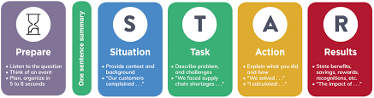
How to Answer Questions (STAR Method)
Situation (20%)
Task (10%)
Action (60%)
Result (10%)

Slide 16
Interview reflections
Asking questions back is incredibly important; oftentimes searches don’t have an ideal candidate in mind, and are testing the waters to see what is available.
Other times they have a very specific individual in mind and the interview is theater, but those are worthwhile experiences as well.
Interviewing is a muscle—the more you do it, the better you get at it. Also, interviews are a terrible way to choose candidates.

Slide 17
What are Questions to Ask Back to Interviewers?
What common factors do successful people at this firm have?
What are opportunities in 2/5/10 years of working here?
What does professional development look like at your firm?
What does a successful candidate look like in 30/60/90 days?
What is something not listed in the job ad that you would be thrilled that a successful candidate brought it to the table?

Slide 18
Following Up
Interviewers usually have other jobs. They need to do these. Give them time. If you interview on a Friday, they aren’t going to decide on Friday. They probably won’t decide on Monday. Or the next Friday.
Immediately send digital thank you’s, if you can also hand deliver thank you notes to a receptionist or office manager after the interview. Takes ten minutes, shows you care.
If two weeks go by (sometimes sooner) send a friendly follow-up. Ask about process or where the committee is in the decision making process. I’ve never heard of someone not getting hired b/c they sent one follow up email (whereas sending nothing could be detrimental).

