Slide 1

Public Relations Research Methods
Intro to PR Data and Methods

Slide 2
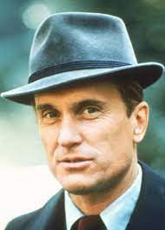
PR vs Ad, and the Consigliere Role
PR often functions in a more advisory role than ad or SM or digital programs. So if we are to speak from wisdom, we need some form of expertise to back it up. What can we refer to in a meeting if everyone has differing opinions?
“Technical (practitioner) to management function (professional” (Stacks, 4).
Robert Duvall as Tom Hagen in The Godfather. Duvall was legal (and extralegal) counsel for Brando and his crime family.

Slide 3
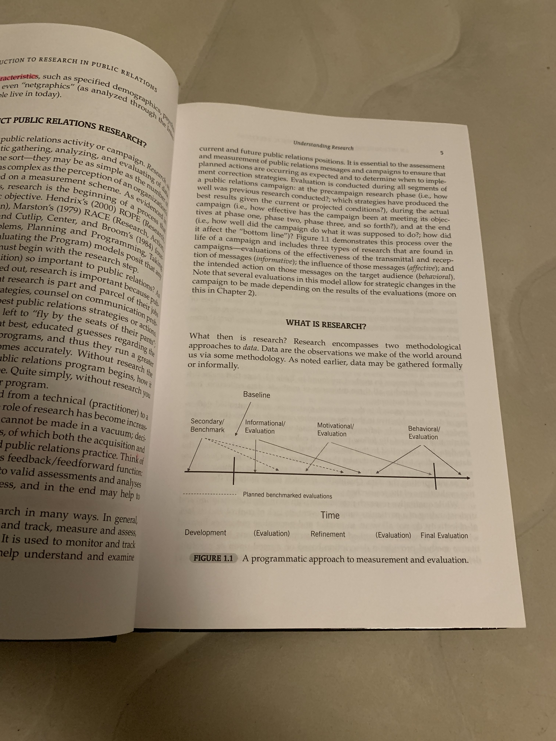
What is Research
Data: recorded observations as we make about the world around us.
Informal methods involve intuition, how we feel about something; more formal methods involve objective, replicable approaches

Slide 4
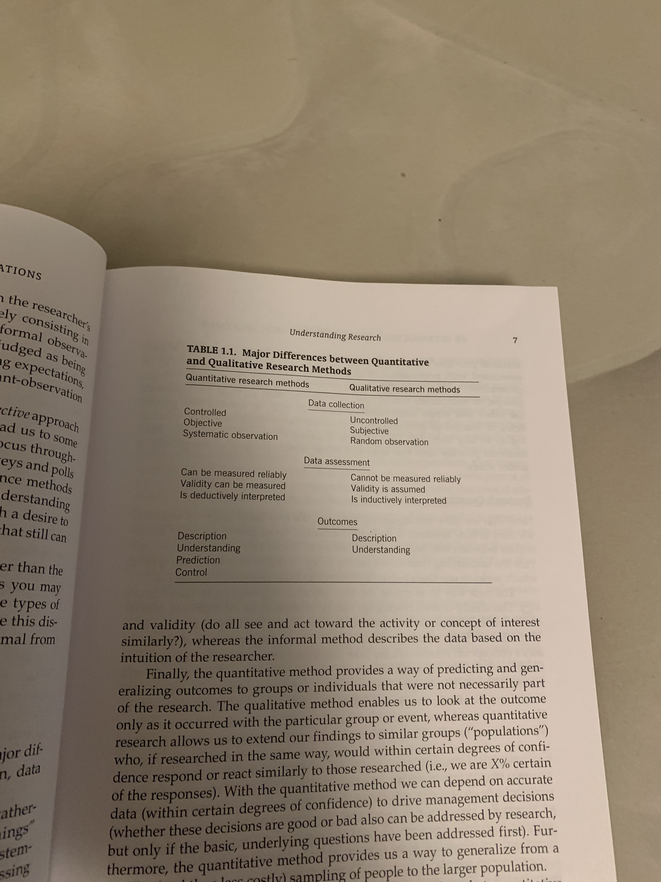
Quant vs Qual

Slide 5

Choosing a Method
If a tree falls in the forest, and no one is around, does it make a sound?
PollEv.com/robertfoschi171

Slide 6
Quant vs Qual
Quantitative is objective, systematic, and controlled. The researcher defines “things” under the study. It is systematic in that there are formal rules and processes to follow
Qualitative is not anything goes, but rather relies on the subjective evaluations of the researcher. Stacks already fields a somewhat negative view here, but qualitative research is also rigorous and thorough, usually relying on text than numbered assessment.

Slide 7
Quant versus Qual
Quantitative methods often give us a cheap and easy way to predict behavior about populations (Sample a small group, extrapolate that to the whole). It is the foundation for making management decisions and huge costs.
However, alone it can also produce content such as this, where it checks all the boxes but the forest is missed for the trees.

Slide 8
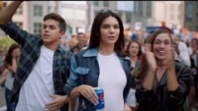
Pepsi Ad, With All the Things

Slide 9
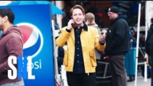
Pepsi SNL Spoof

Slide 10
Research Questions
Theoretical- research for the sake of research, interesting questions, understanding methods, understanding foundations, moves us to think about how we work (architect)
Applied—how to mobilize research to better campaigns and hit targets, moves us to do things (builder)
PR is interdisciplinary: communication, psychology, sociology, management, marketing research all funnel into the practice

Slide 11

Questions of Definition
Attempting to pin down a specific attitude or belief and understand it.
  A premier example of this is Frank Luntz (wait for focus groups) was a political operative who, through questions of definition, was able to shift public sentiment from ‘global warming’ to ‘climate change’. The official term is ‘global heating’ or ‘global warming’, but Luntz found that climate change sounds more natural, not as scary, and more appealing to a wide swath of voters.

Slide 12

Questions of Fact
Used to compare across or between groups. Typically empirical measures.
  Essentially, an A/B test. Will message A generate more blood donations in this time frame, or does message B actually work better? We see this across social everyday.
  Benchmarking and baselines needed for controls.

Slide 13

Questions of Value
How “good” or how well something is doing, usually done with a Likert Scale.
  Do you think the president is doing a good job? Strongly agree, agree, neutral, disagree, strongly disagree
  Qualitative measurement typically for assessing worth and value. Survey or focus group research.

Slide 14

Questions of Policy
What ‘should be done’ style questions.
  Very applied, usually in political or government relations-type roles, or those working in the policy sector (energy, climate, immigration, etc.).
  Typically theoretical. If we install x number of heat pumps, this area can have the savings of y for their energy bills in a year. We ran a simulation…
  …Because actually forcing a town to buy heat pumps as part of a study is impossible/authoritarian. So typically there is no way to apply these questions unless the policy becomes law.

Slide 15
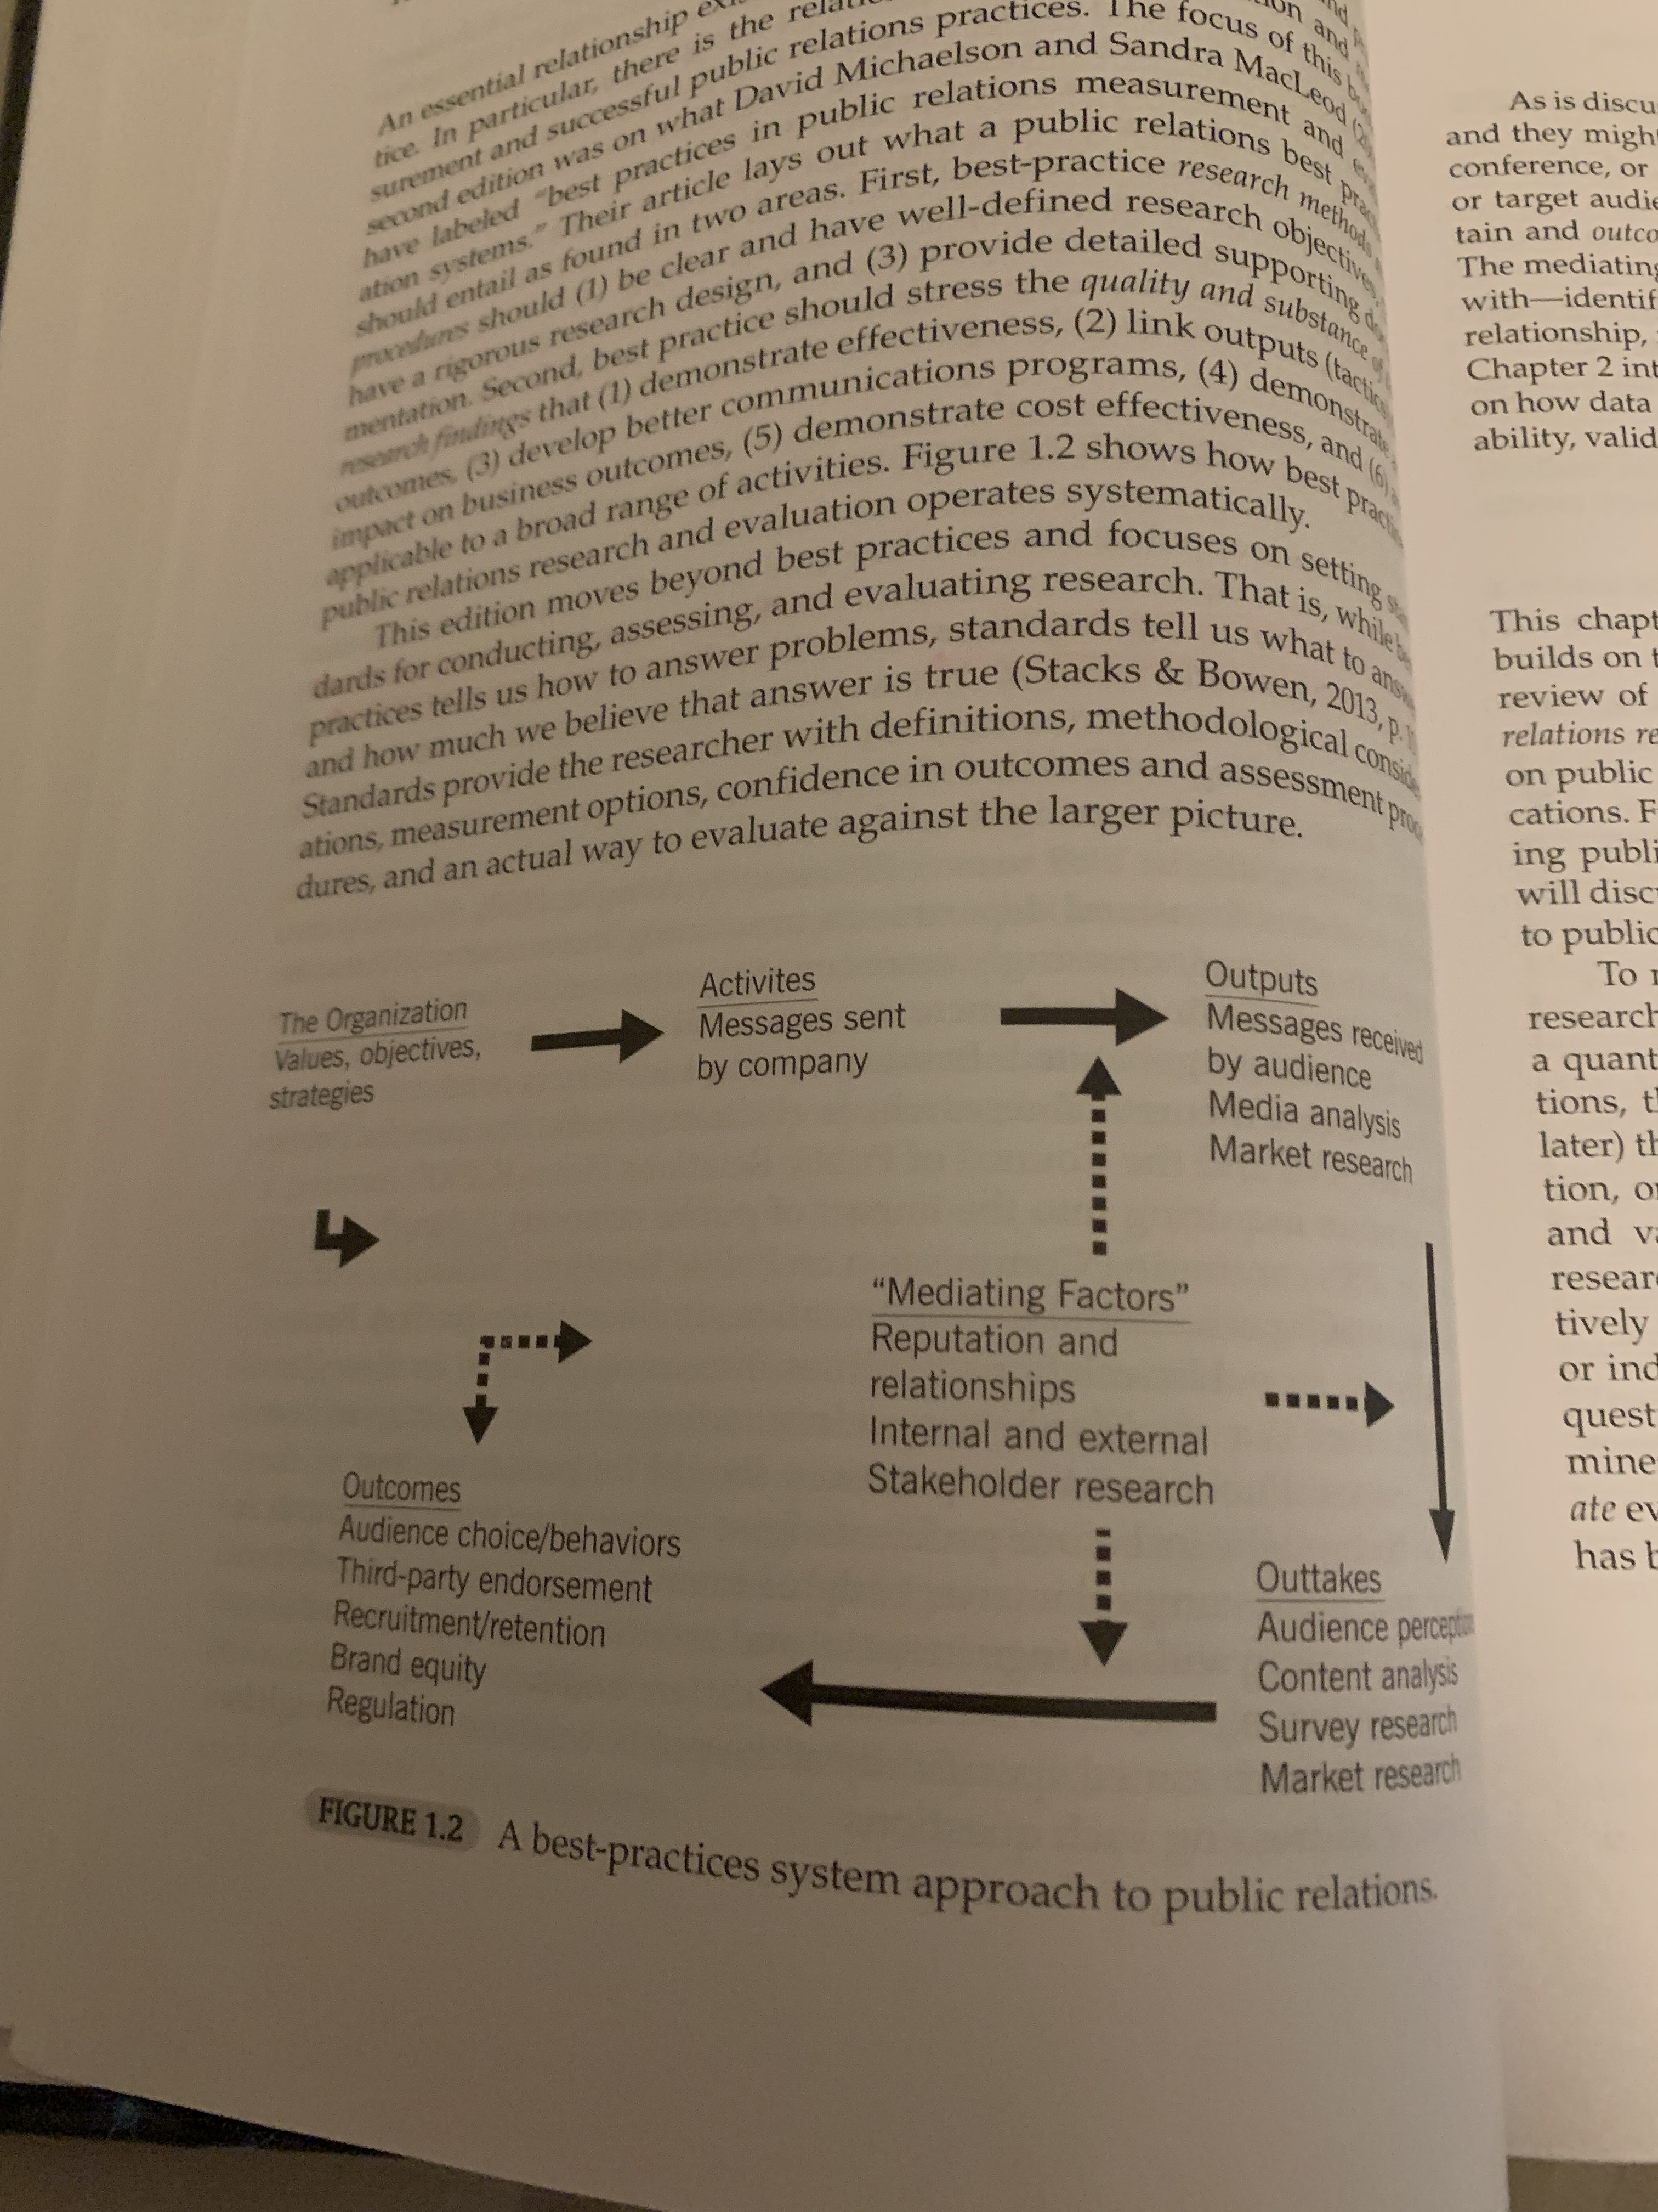
Best Practices
Setting standards for what PR should do.
  Outputs: tactical, single actions that contribute toward the larger goal (coming to class, doing assignments, etc.,)
  Outtakes: perceptions that influencers or stakeholders have about a given topic (perceptions about the class that assignments are geared to help you learn to be a better PR professional)
  Outcomes: behaviors the campaign is trying to instill or change (doing PR research, getting an A if you are a student, etc.)

