Slide 1



Group & Team Dynamics
July 9nd, 2026
Robert Foschia
CAREER & LEADERSHIP SKILLS ACADEMY

Slide 2
Why Does everyone hate group work?
I assign team projects in one of my classes, and everyone groans—so why do we do this? To punish students? Make grading easier? ’Prepare for the workplace’?
Teambuilding and working with others is a skill like many of the issues covered over the last few weeks. You need to work at it. In fact, the problem of ‘other people’ is not only NOT going away, it will become a larger presence in your lives

Slide 3
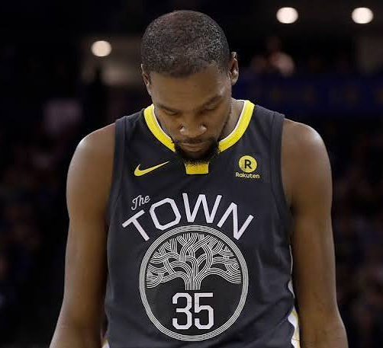
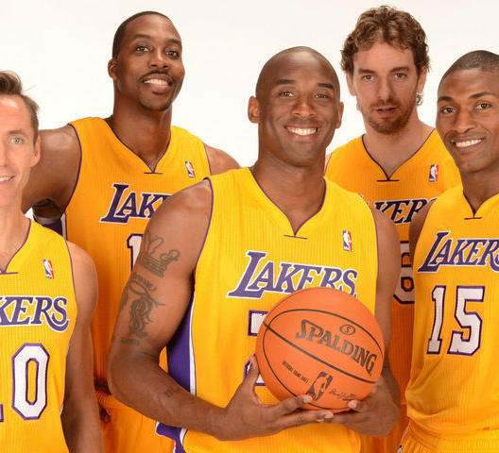
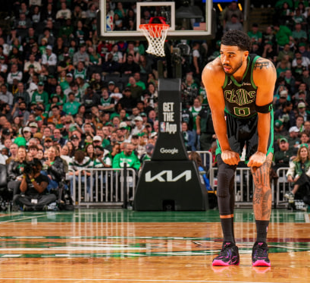
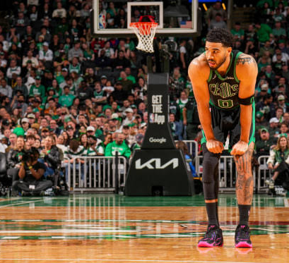
Why Team Dynamics Matter
Org performance is team based-–working across departments on projects
Teams are systems; individuals can’t just be slotted in

Slide 4

Goal-Oriented Management Teams
Workers de-skilled to be more flexible and mobile;
“TEAM” as the “…mythically egalitarian playing field in which all colleagues work together, sharing responsibility for the organization” (Gregg, 2008, 74).
How to develop social cohesion in an organization when it is constantly changing and in flux? (CULTURE).

Slide 5
The Problem With Teams
“Ultimately teamwork narrows workers’ concerns to a set of objectives that fit the requirements for competitive advantage and commercial profit. This is what the euphemistic plaques in the arrivals foyer of workplaces only serve to remind us” (Gregg, 2008, 85)
  Routines reproduce themselves over and over again as they become habits.
  Benefits of email to organization are both ideological and financial; stresses worker friendships to extract excess labor.

Slide 6
Barriers to Effective Teams
Unclear Roles
Poor Communication
Hidden Agendas
‘Free Riders’ or social loafing
Absent Leadership

Slide 7
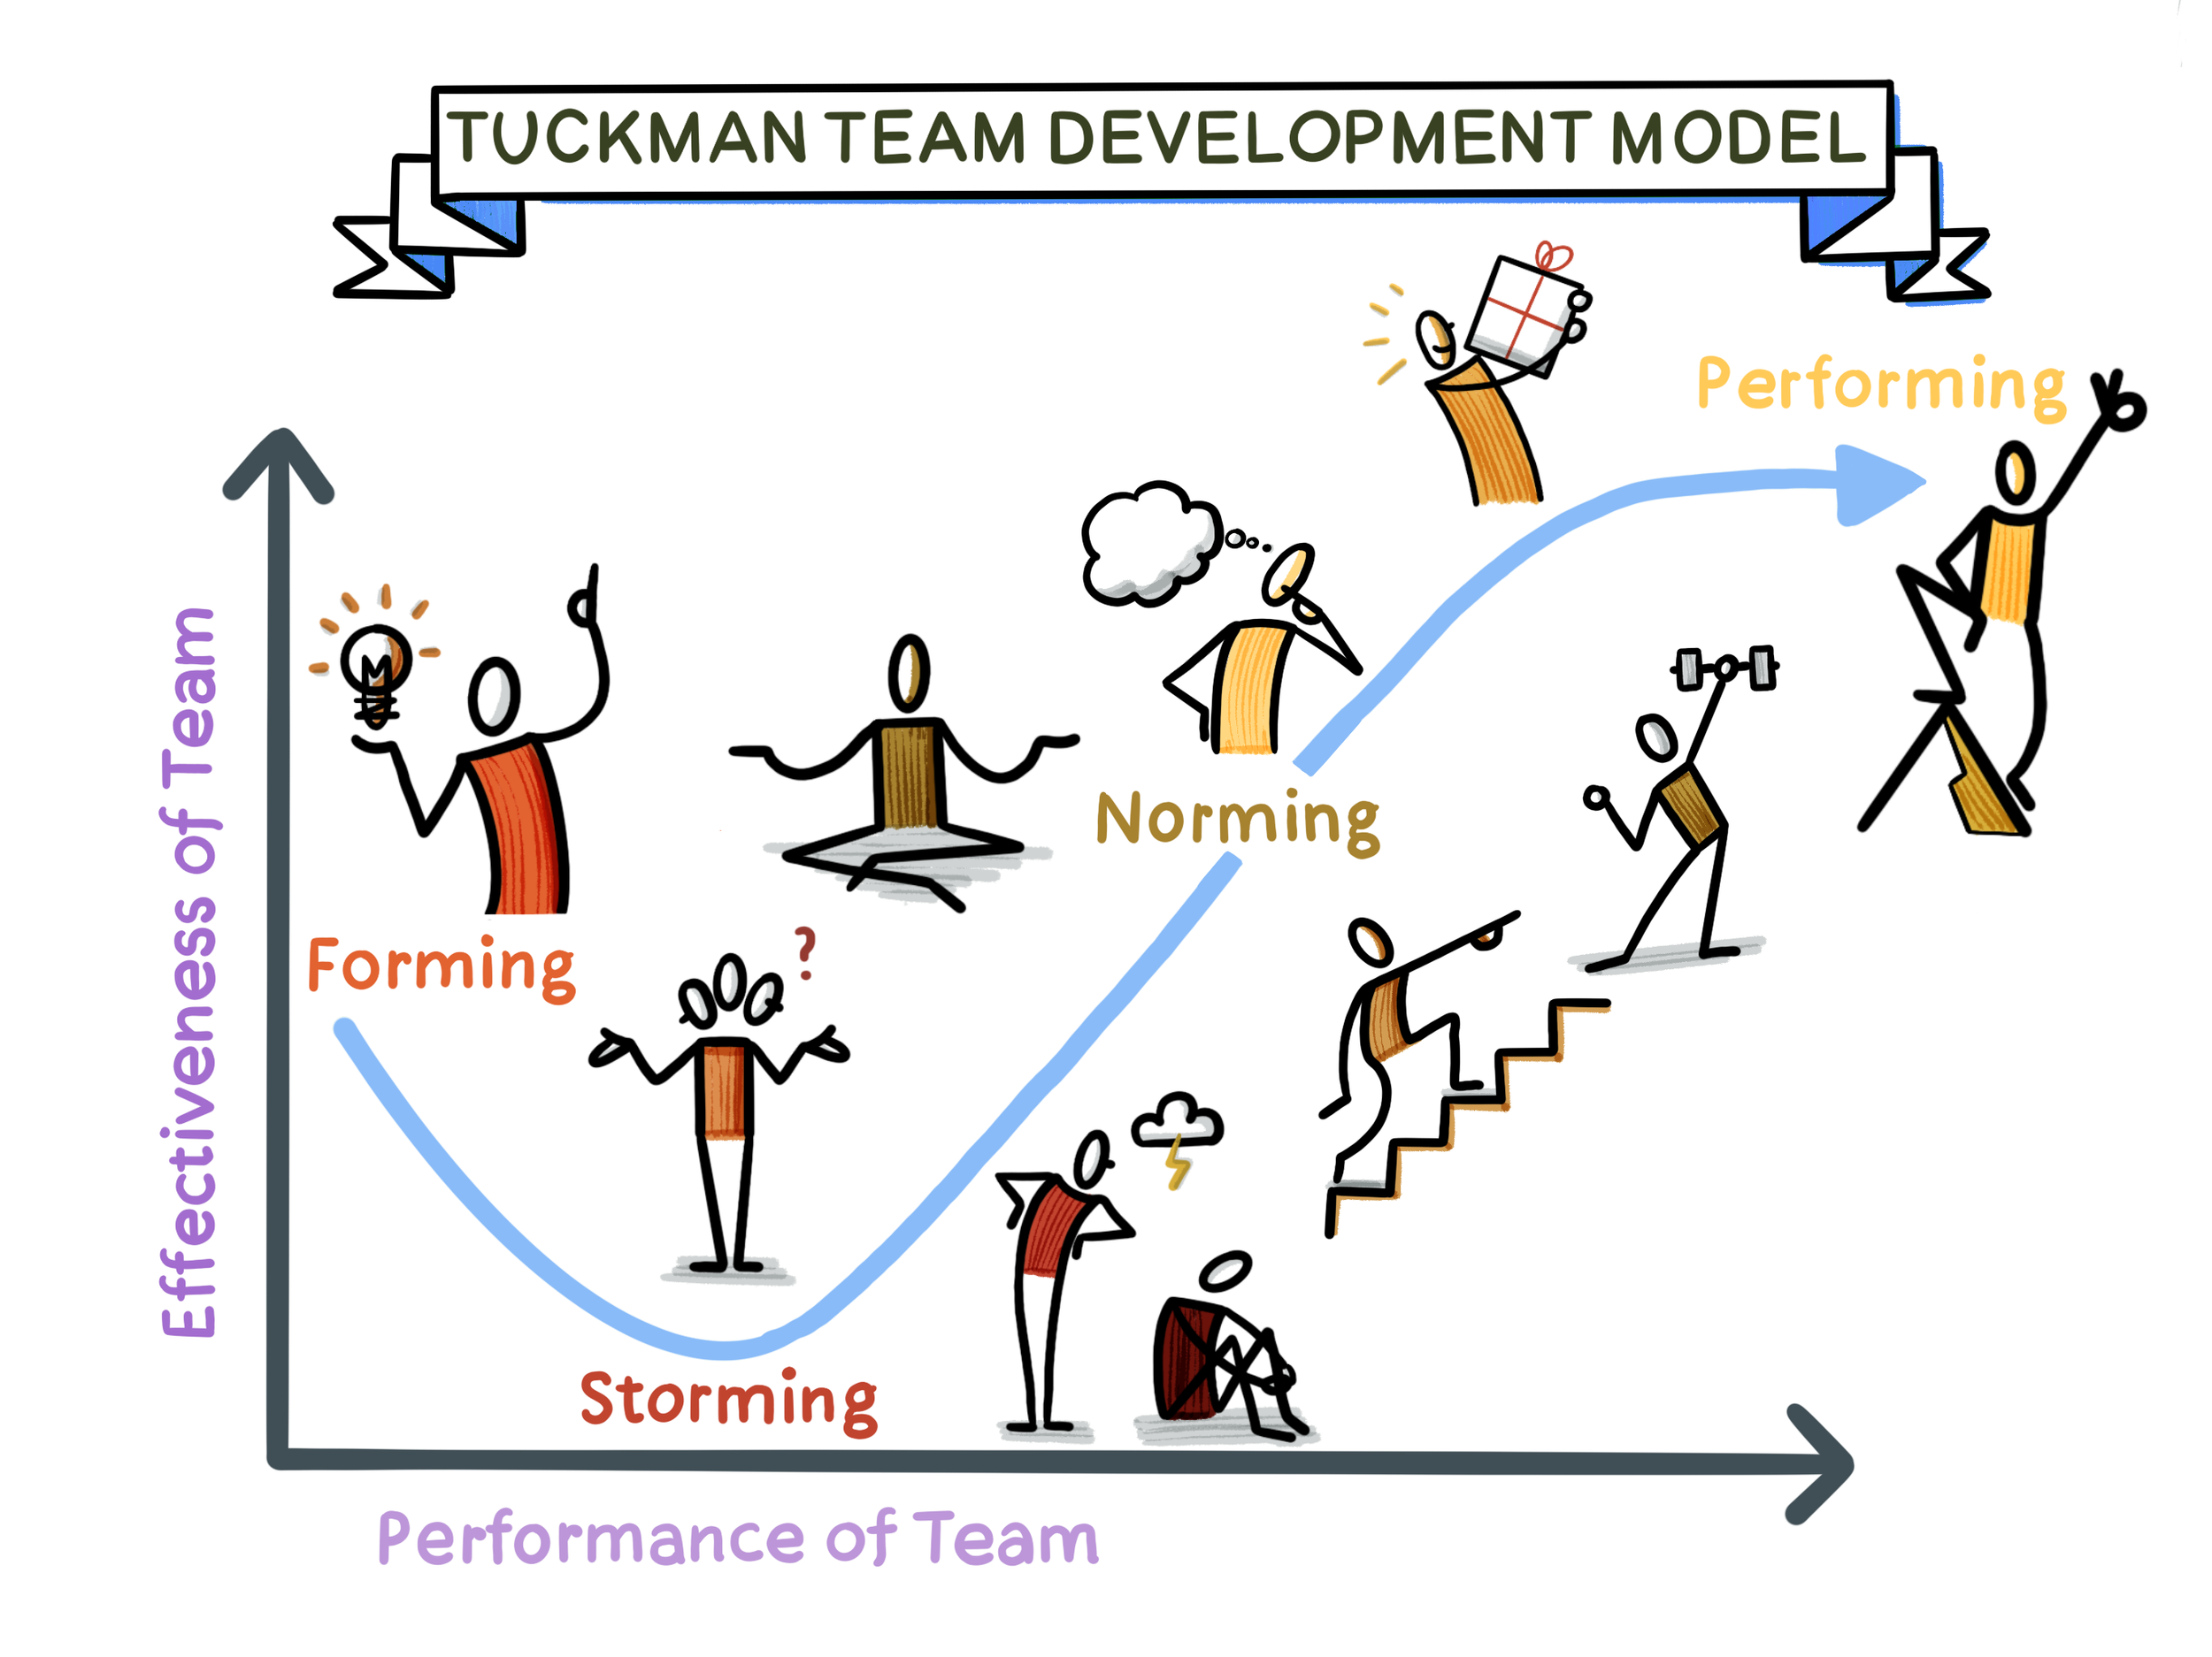
Tuckman model

Slide 8
Tuckman Model
Forming
Storming
Norming
Performing

Slide 9
Breakout
Where do teams you have been on get ‘stuck’ in this model? Discuss and talk about the reasons why a team remain at this stage

Slide 10
High performing teams—”Superteams”
Compelling Direction
Strong Structure
Supportive Context
Shared Mindset
Notes:
According to HBR Haas and Mortensen identified two additional problems that plague today's teams — "us versus them" thinking and incomplete information. To combat these, they argue teams need a fourth enabling condition: a shared mindset
Compelling direction — a clear, challenging, and meaningful goal that motivates the team.
Strong structure — the right mix of skills among members, well-designed tasks and processes, and clear norms — a small number of things members must always do (like arriving on time and giving everyone a turn to speak) and a small number they must never do (like interrupting).
Supportive context — a reward system that reinforces good performance, an information system that gives access to needed data, and an educational system offering training — plus the material resources (funding, tech) required to do the job.
Shared mindset — building a common identity and common understanding across a diverse or dispersed team. In practice this means things like creating "structured unstructured time" — blocking off time in meetings to talk about things not directly related to the task — to build shared understanding and turn "us and them" into "we"

Slide 11

What derails superteams
‘Us versus them" thinking
Incomplete information

Slide 12
Pillars of Effective teams
Leadership
Mission and Goals
Communication
Relationships
Development

Slide 13
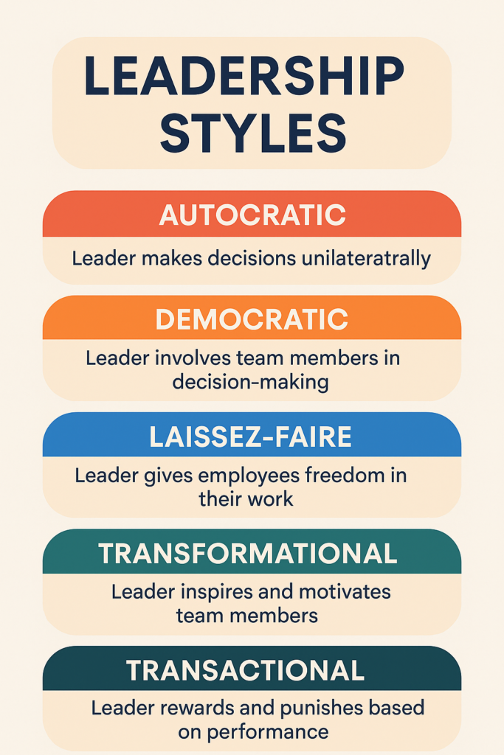
Leadership

Slide 14

Strong Structure
Need a mix or diversity on perspective, age, location, and skill/social adaptiveness
2 Pizza rule: if you have to order more than two pizzas, the team is too large; allows free riders and lack of accountability, or too-many-cooks-in-the-kitchen scenarios

Slide 15
Mission and goals
Alignment—first of all, making sure everyone is working towards the same goal, and that everyone is aware this is the goal.
Making sure the goal is measurable or definable; vague allusions to something can be moved end of quarter/year and create distrust
Purpose—what keeps us coming back to finish the job?
Notes:
Alignment is often derailed by agendas, or thinking people have agendas
Purpose as almost religious like zeal that sustains, man’s search for meaning high on the needs list

Slide 16
Communication
Clarity
’Looping In’—Communication goes more than one way, there are ideas coming top-down, bottom-up, and horizontally
Active Listening—what does this request actually point to? What does this person want?

Slide 17

CC’ing
Is Email the responsibility of the individual or the organization? What communication contracts have you entered into in your professional lives?
Email as distraction.
Email as signifier of professionalism—allowing everyone else to “get on” and being a team-player.

Slide 19
Relationships
Trust
Celebrating Small Wins
Conflict as the end of the team or a growth opportunity
Notes:
There are no atheists in a foxhole—crisis reveals leadership but also the bonds that have been made

Slide 20
Breakouts
What allows you to critique/question a superior? Have you ever done this, and if so, do you feel like it was for the betterment of the team, or more a personal conflict?

Slide 21
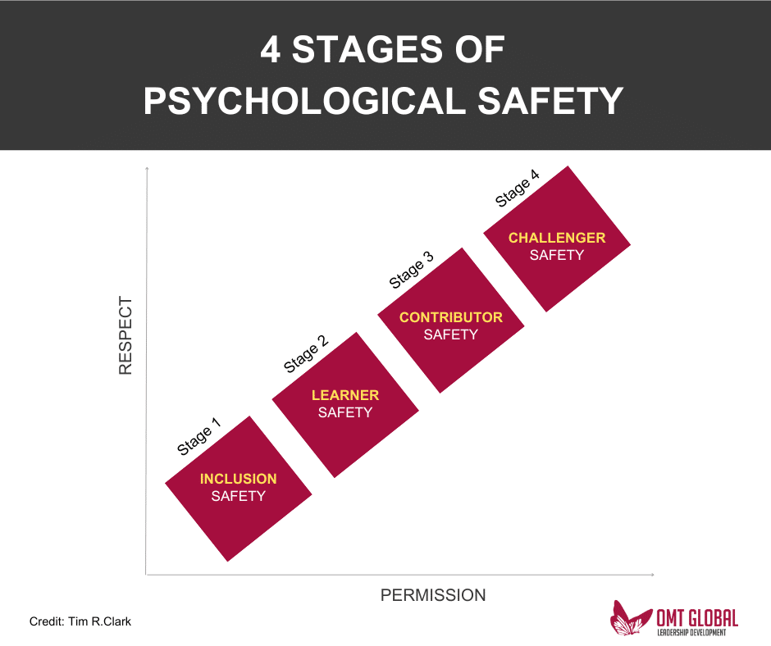
Psychological safety

Slide 22
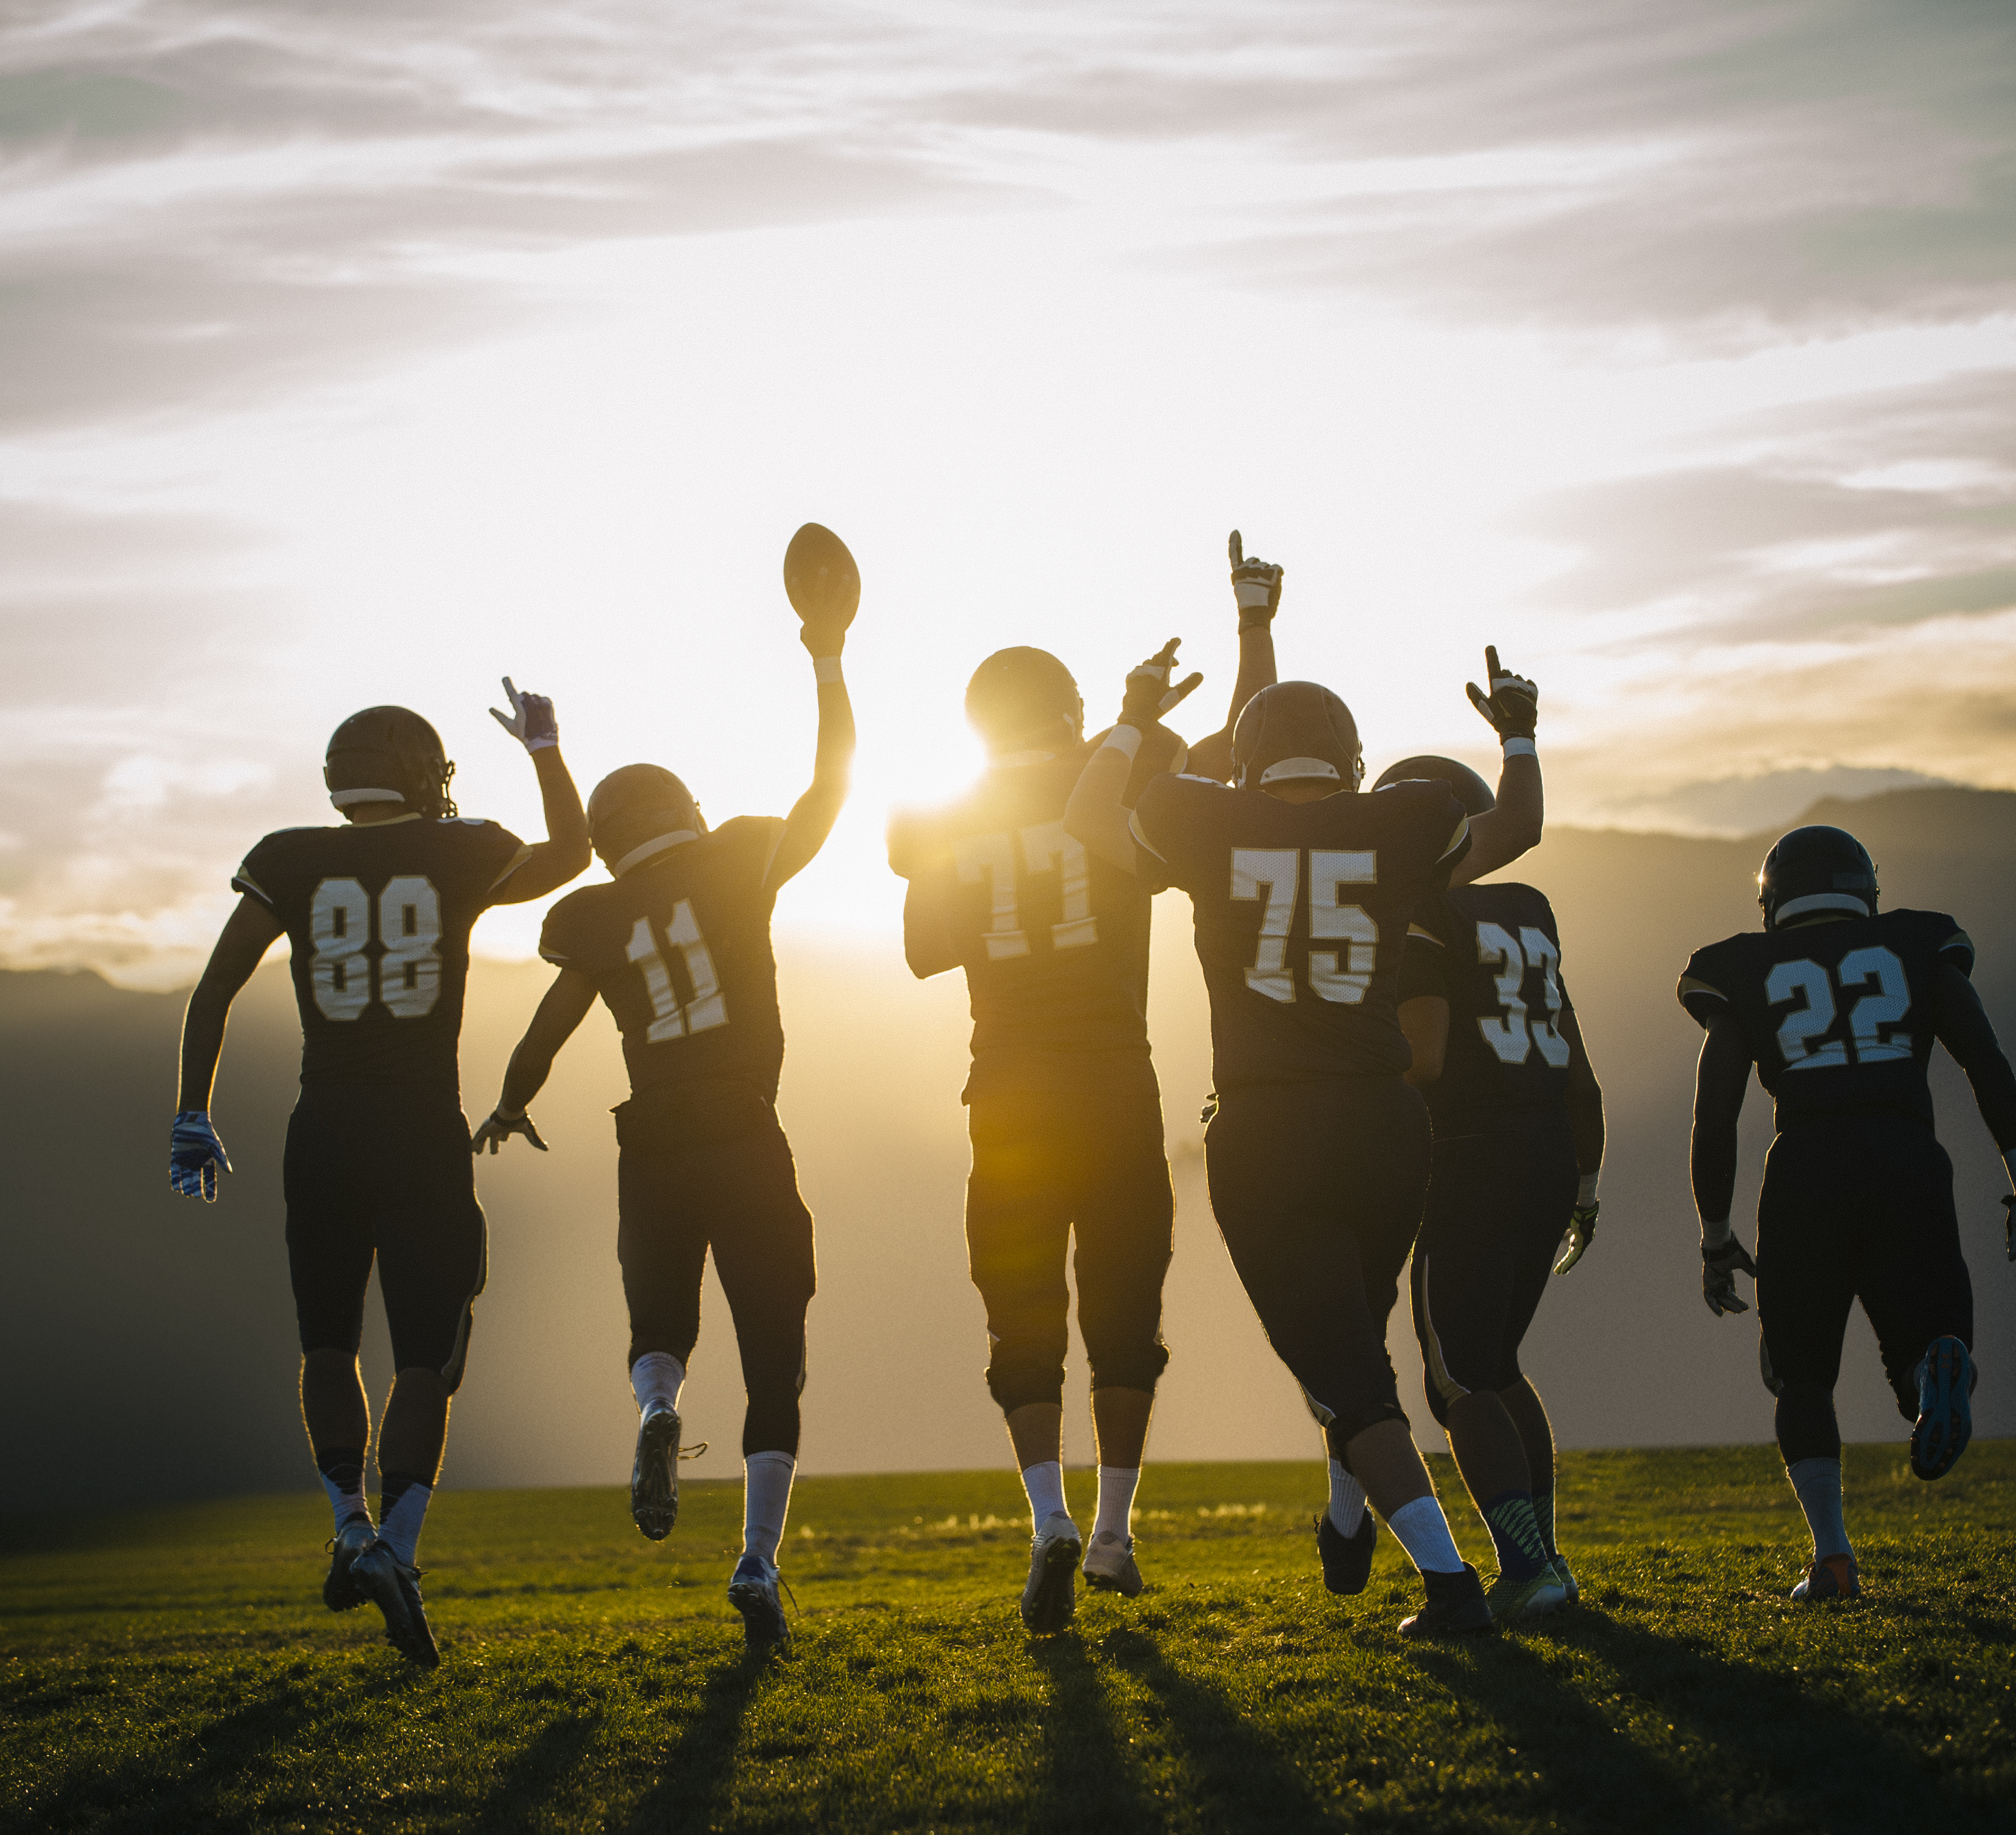
Contracts, Social and Psychological
Even in profit-only corporations, the team and the worker are valued in internal comms b/c it helps “…absolve workers of the need to generate intrinsic motivations for the job” (76).
HR helps set the stage for how employees interact with one another.
  Telecom Claire: sense of responsibility motivated her
Notes:
Going to work everyday, we may lose motivation to look at the same spreadsheets; but, if we know we must keep going to help Steve, Jim, Alice, whoever—it creates a sense of face-to-face responsibility to the other person. Not working for the corporation but for those around us

Slide 23
Development
The “I” and the “We”
If we do not believe we are getting any skills or experience out of the team, we check out.
Finding a mentor, being a mentor

Slide 24
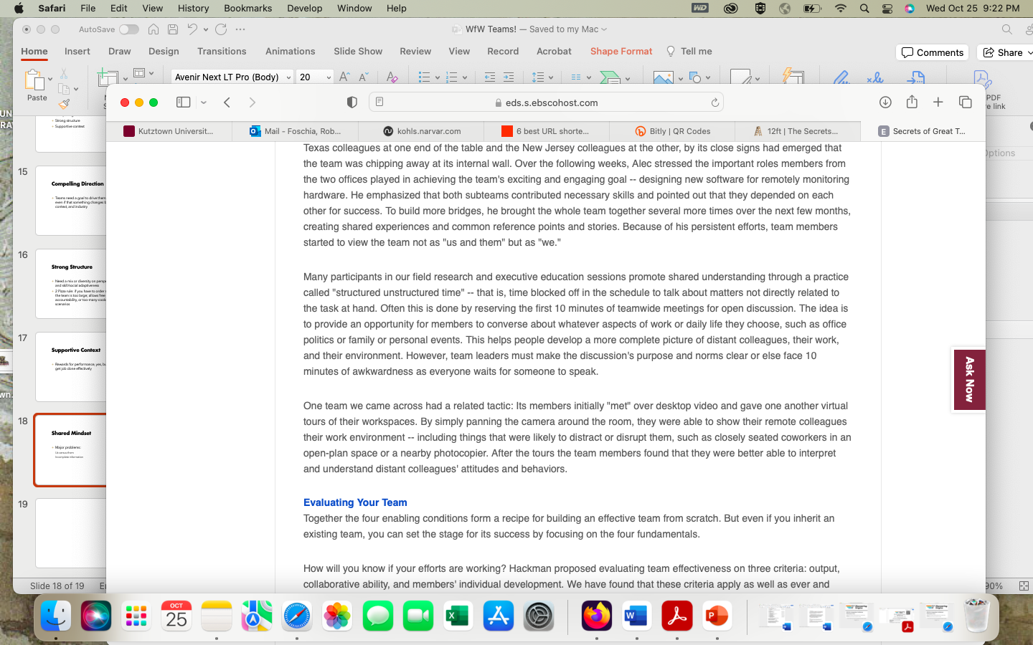
Serendipity

Slide 25
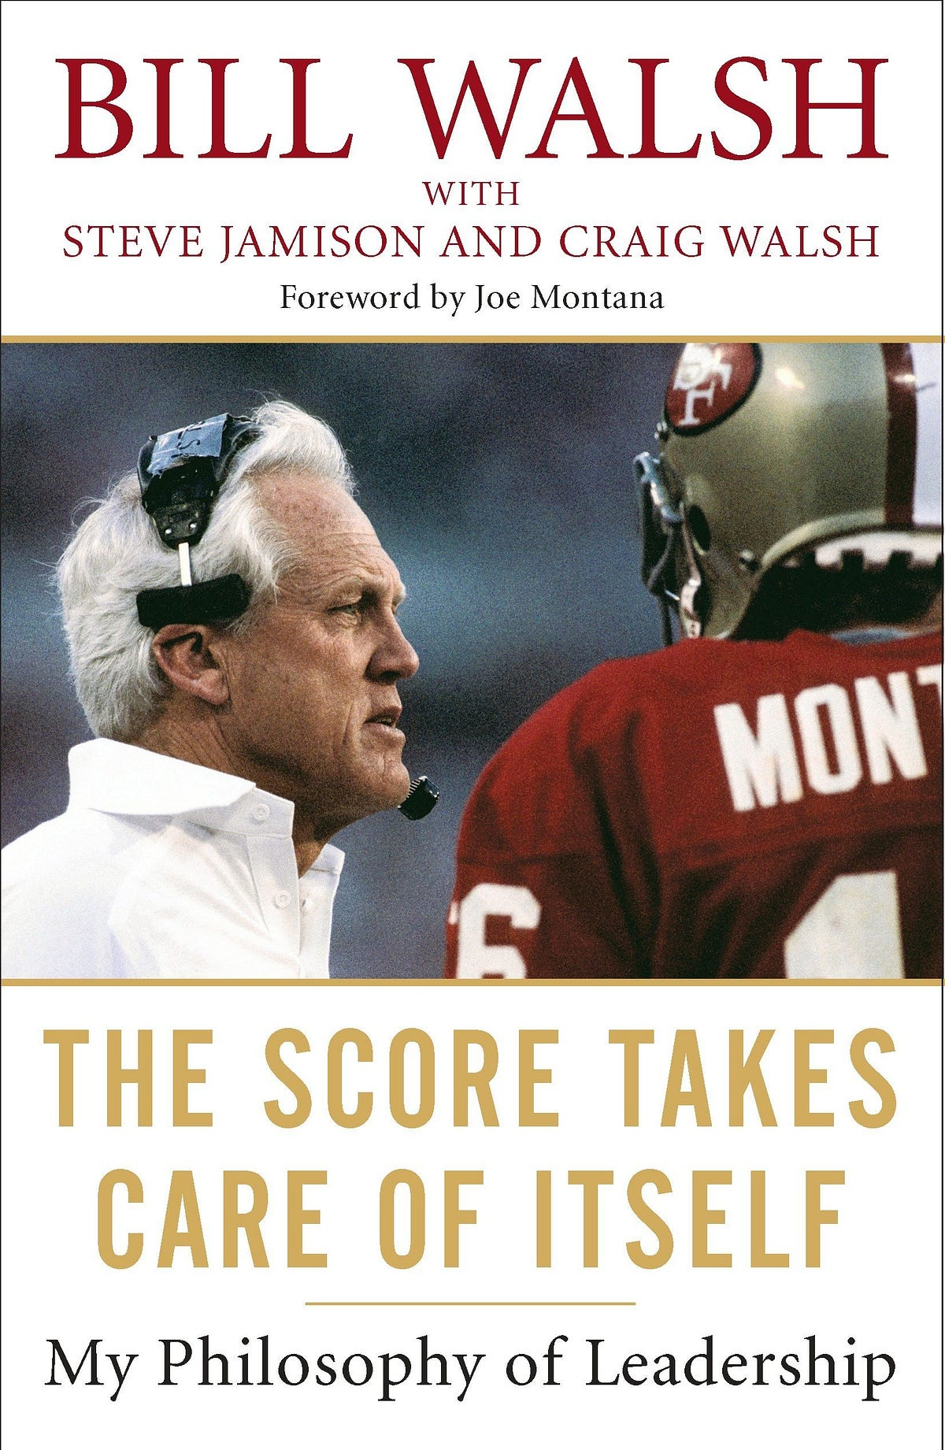
If we are all thinking the same, then we aren’t thinking”
GroupThink
Notes:
Psychological safety, so people feel safe voicing dissent
Assigning a devil's advocate or structured debate
Structured discussion processes and retrospectives
Actively soliciting outside perspectives and unique knowledge (not just consensus-building)
Keeping teams smaller and more diverse to widen the range of viewpoints

Slide 26
Cognitive Biases in teams
Anchoring bias
01
Confirmation bias / IKEA Effect
02
Availability heuristics
03
False Consensus
04
Survivorship bias
05
Zeigarnik effect
06
Bandwagon effect
07
Notes:
Anchoring effect—we go with the first statement thrown out there, or we become stuck on it
Confirmation bias—we tend to agree on the thing we’d like to be true
Zeignarik Effect—we hold onto previously incomplete tasks rather than moving forward
Availability Heuristic—fear of flying so you drive because it is easier; use of emotion in decision making

Slide 27
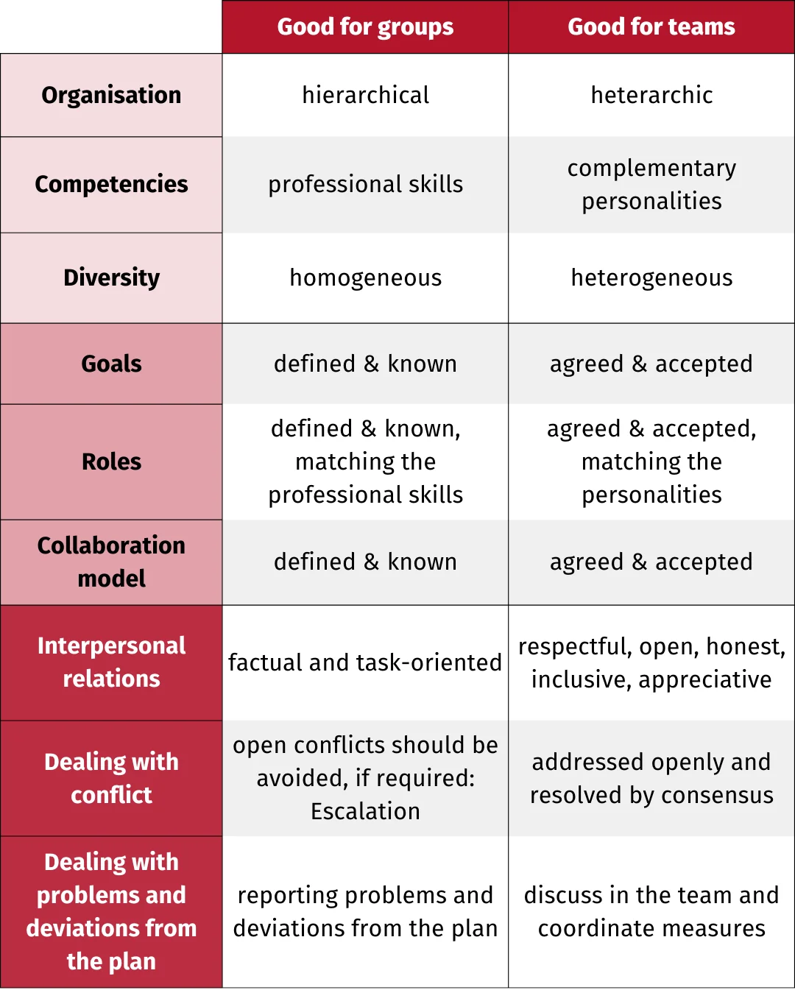
Teams vs groups

Slide 28
Work teams vs work(ing) group
Square and Rectangle Theory: Not all groups are teams, teams are elevated groups that are more than the sum of their parts
Dynamic—Not only is output amplified, but leadership, communication, and responsibility are shared
A group can function perfectly well getting tasks done; a team needs enabling conditions to succeed

Slide 29
Insist on doing everything through ‘channels’. Never permit short-cuts to be taken in order to expedite decisions.
Make ‘speeches’. Talk as frequently as possible and at great length. Illustrate your ‘points’ by long anecdotes and accounts of personal experiences.
When possible, refer all matters to committees, for ‘further study and consideration’. Attempt to make committees as large as possible—never less than five.
Bring up irrelevant issues as frequently as possible.
Haggle over precise wordings of communications, minutes, resolutions.
Refer back to matters decided upon at the last meeting and attempt to re-open the question of the advisability of that decision.
Advocate ‘caution’. Be ‘reasonable’ and urge your fellow-conferees to be ‘reasonable’ and avoid haste which might result in embarrassments or difficulties later on
Be worried about the propriety of any decision. . . . It might conflict with the policy of some higher echelon.”
CIA Simple Sabotage Field Manual; https://www.hsdl.org/?abstract&did=750070

Slide 30
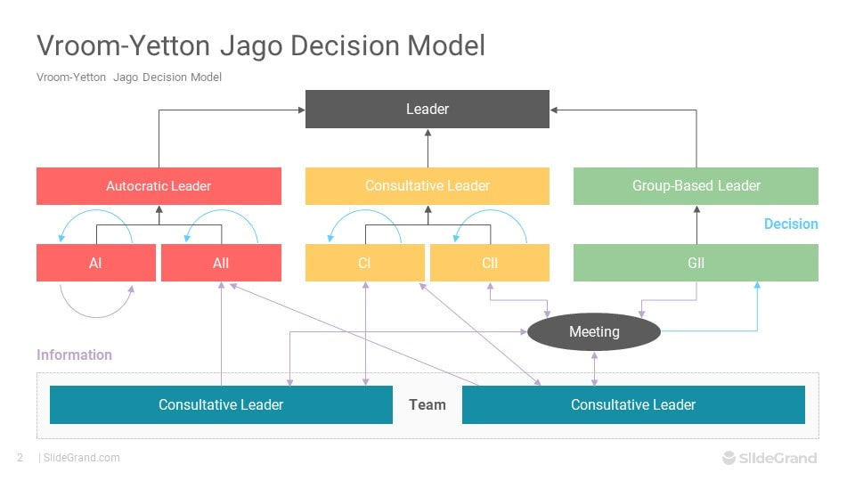
Group decision making

Slide 31
Group decision making (Vroom & Yetton)
Autocratic Type 1 (AI)
Autocratic Type 2 (AII)
Consultative Type 1 (CI)
Consultative Type 2 (CII)
Group-based Type 2 (GII)
Notes:
1--Is there a quality requirement? Is the nature of the solution critical? Are there technical or rational grounds for selecting among possible solutions?
2--Do I have sufficient information to make a high quality decision?
3--Is the problem structured? Are the alternative courses of action and methods for their evaluation known?
4--Is acceptance of the decision by subordinates critical to its implementation?
5--If I were to make the decision by myself, is it reasonably certain that it would be accepted by my subordinates?
6--Do subordinates share the organizational goals to be obtained in solving this problem?
7--Is conflict among subordinates likely in obtaining the preferred solution?

Slide 32
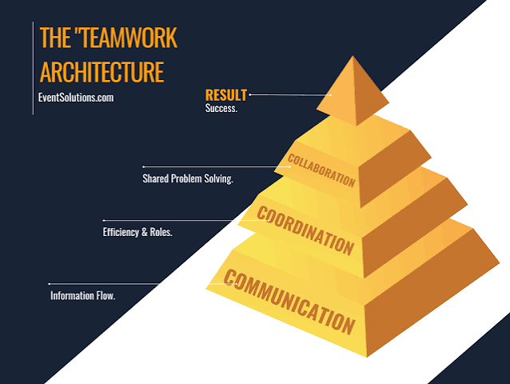
Communication Coordination Collaboration

Slide 33

AI in Teams
The move towards automation was already underway, while AI may boost individual productivity, leaders seeking to use it to reduce headcount may find themselves with contractors and not team members

Slide 34
AI in Teams
You have a team member who to your mind is a ‘social loafer’—they present in front of your board a presentation that is visually great, but shallow. Board asks follow-ups the teammate cannot answer. Later, they admit they did the entire report with AI and did not have the knowledge base needed.
  What do you do?

Slide 35

Have a great rest of your day!
CAREER & LEADERSHIP SKILLS ACADEMY

