Slide 1
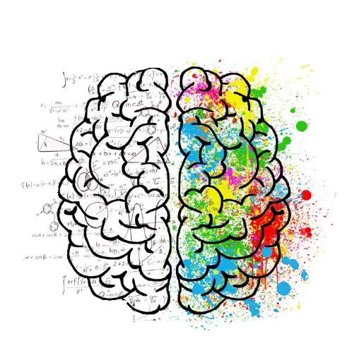


Emotional Intelligence
July 2nd, 2026
Robert Foschia
CAREER & LEADERSHIP SKILLS ACADEMY

Slide 2

Why does mgmt want eq?
Management… involves the coordination and administration of tasks and resources to achieve organizational goals.

Slide 3




Animal spirits
Peacock
Tiger
Owl
Koala
Persuasive
Social influence
Deep understanding of people
Dominant
Sole decisionmaker
Inducing fear in people
Motivational
Ultimate team player or coach
Focus on social/emotional environment
Conservative
Rule follower
Process over people
Notes:
Review: basic leadership styles. We also took some time to talk about aspirational goals of what we wanted to become or skills we wanted to adapt. Rule follower Owl who values process over people but maybe you want to add skills that incorporate the koala motivational piece for times that have big change for your workplace or a big project that requires a lot of creativity.

Slide 4

Notes:
We understand the “what” of the different leadership styles, but…how do we become GREAT leaders?

Slide 5
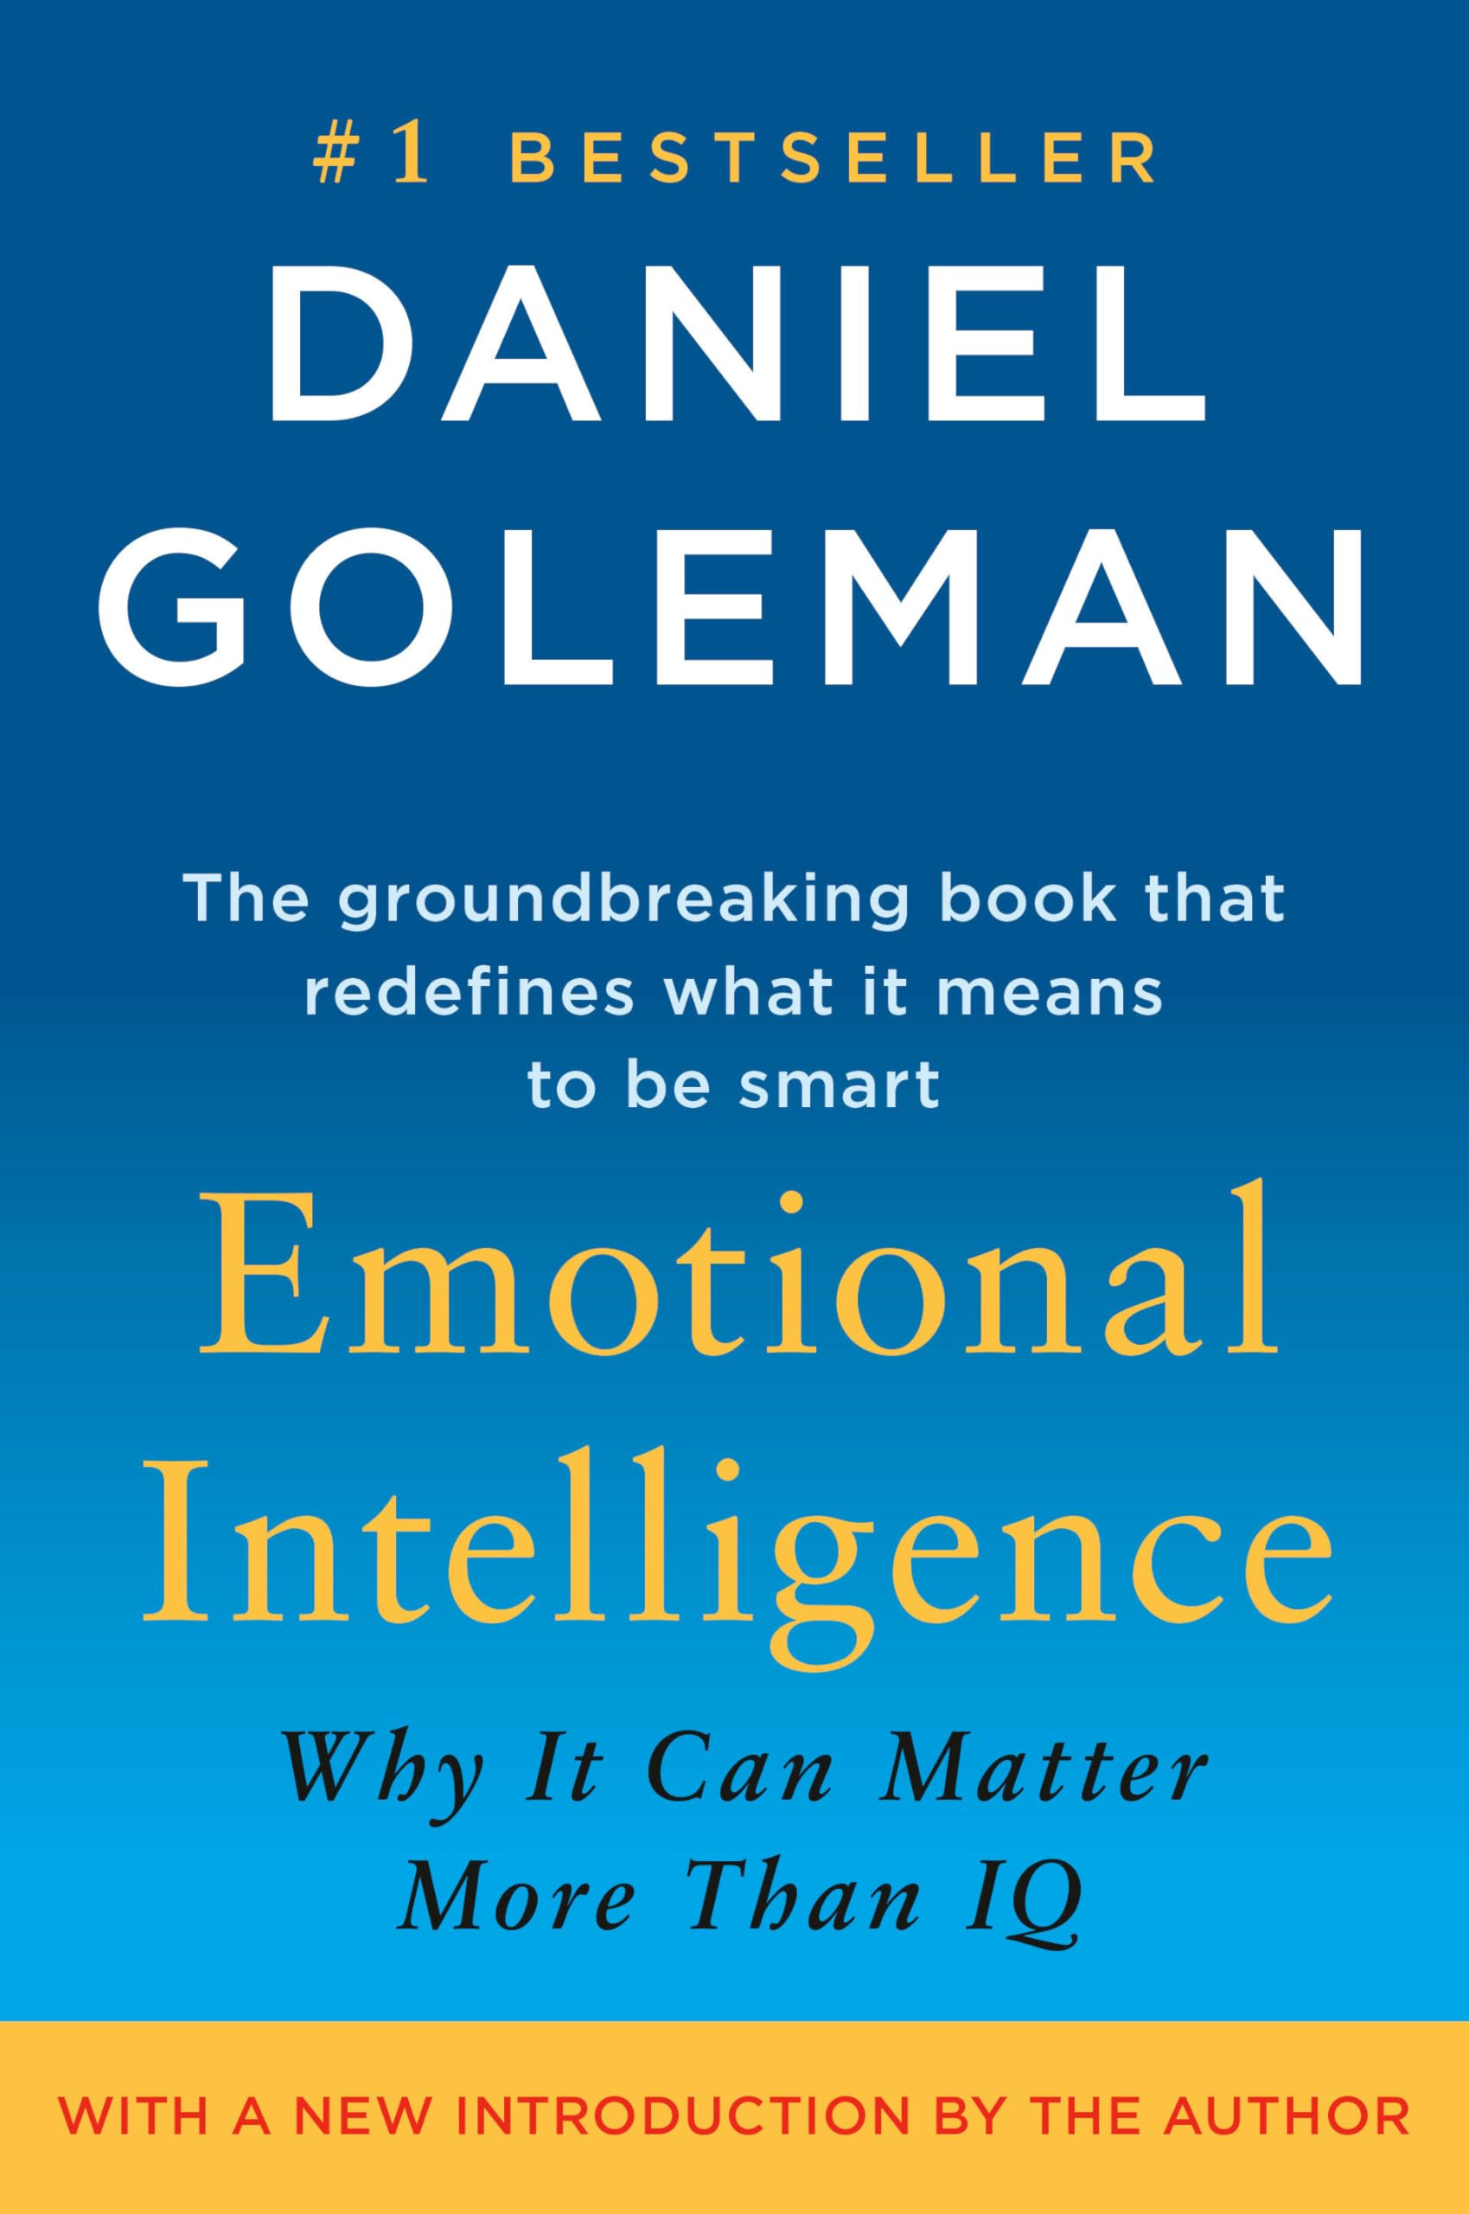
EQ (Emotional Intelligence)
The ability to recognize, understand, and manage your emotions, and to recognize, understand, and influence the emotions of others.

Slide 6
Goleman’s model
Self-awareness
Self-management
Social awareness
Relationship management

Slide 7
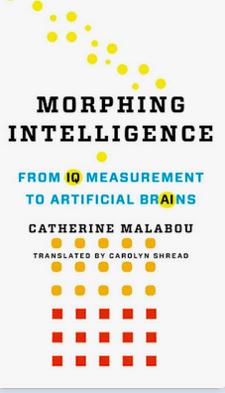
IQ vs EQ
Intelligence quotient (IQ) is a measure that emerged from studies in biology in the 1800s; measurable, fixed number
Emotional Quotient (EQ) is less of a measurement and more of a mindset for approaching others in the workplace with a relational perspective

Slide 8
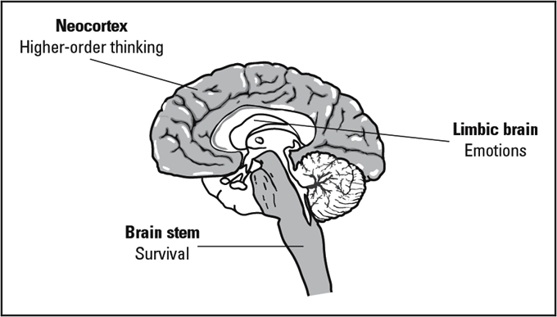
Notes:
What is the science behind it?

Slide 9
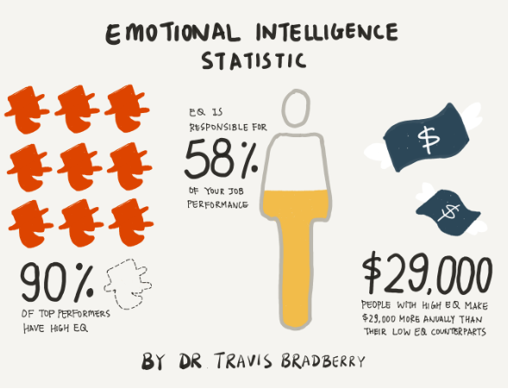
Notes:
BUT WHY DOES IT MATTER?

Slide 10
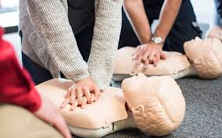

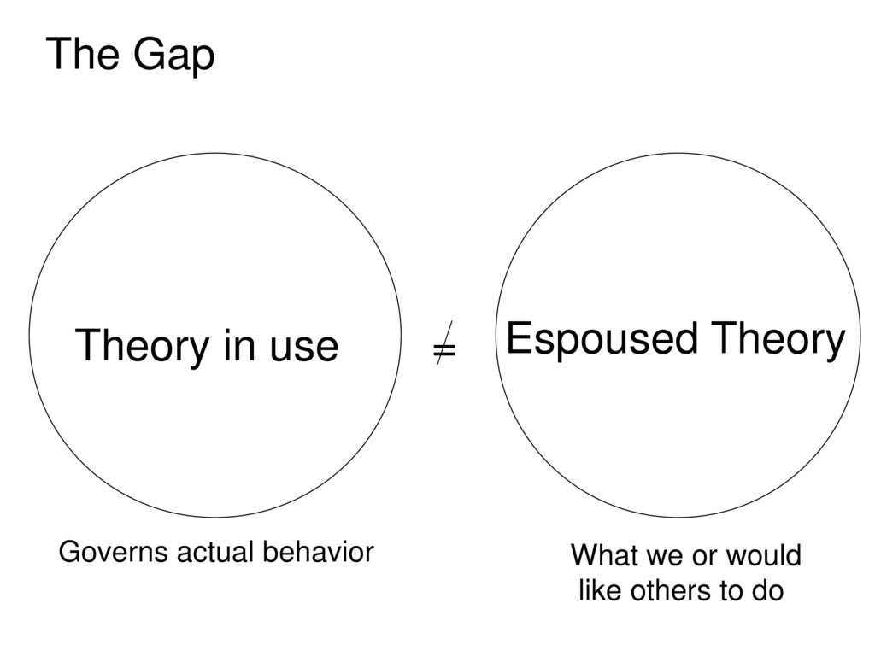


Slide 11
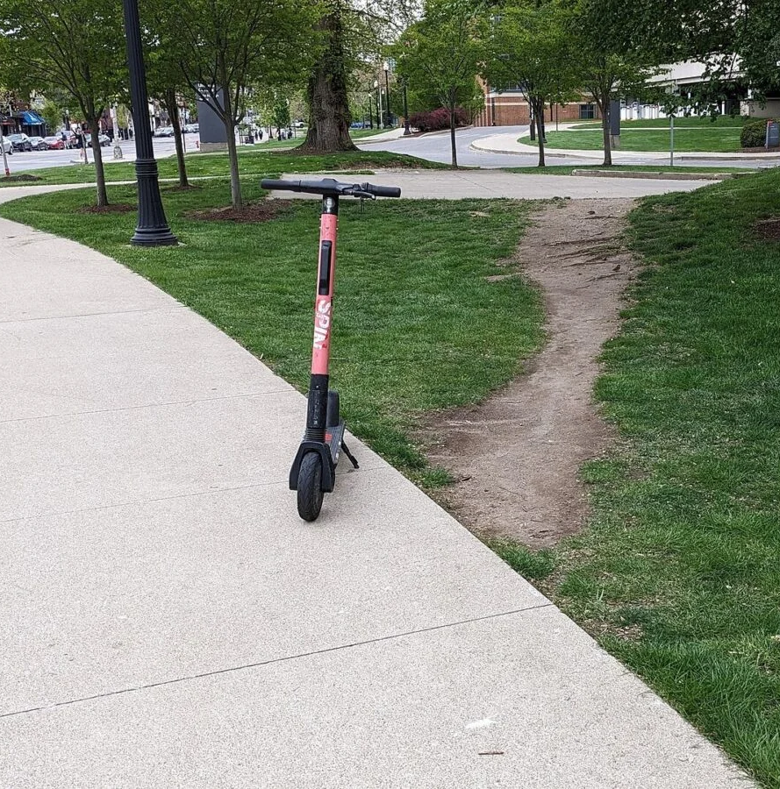


Slide 12
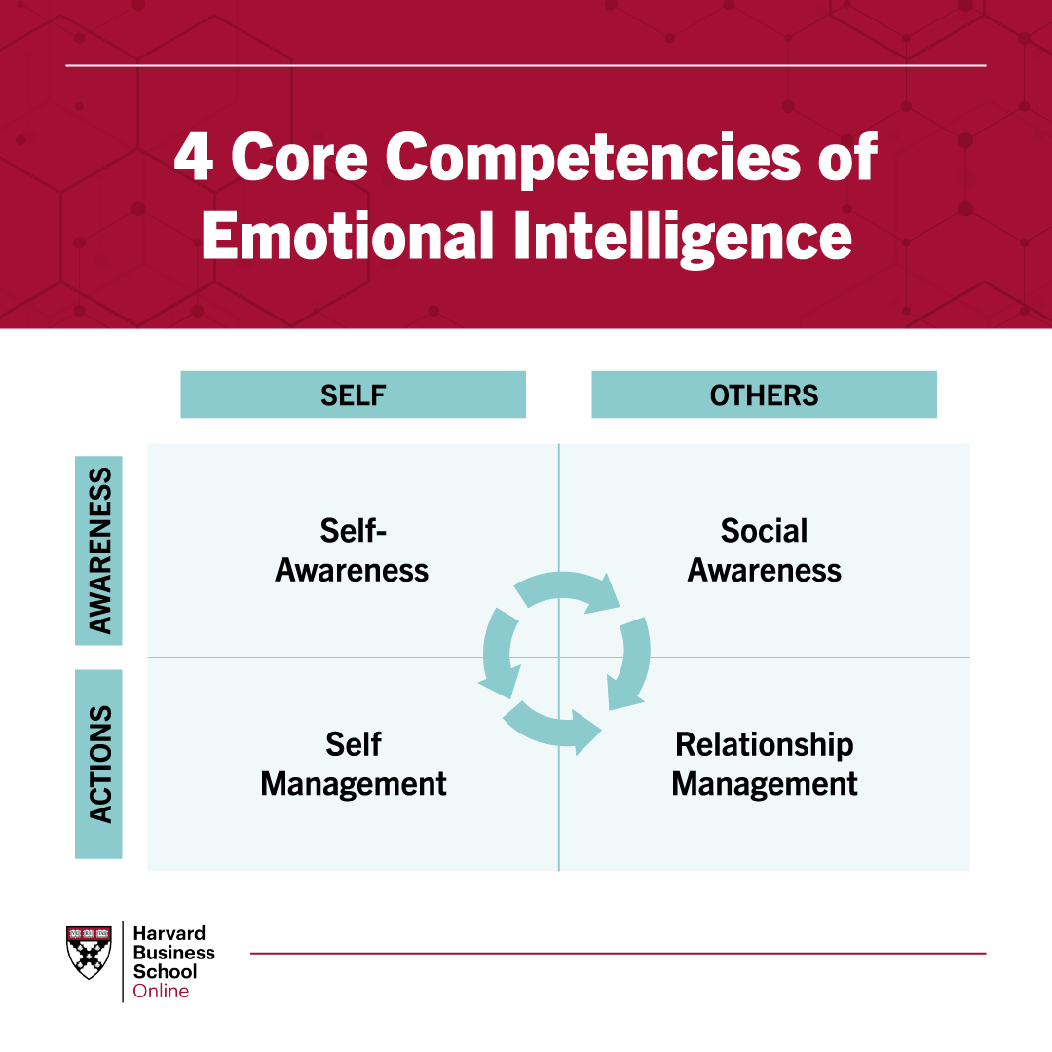
Goleman’s Model

Slide 13
Self awareness
At work, no one is going to identify as having low self-awareness—this comes after our interactions with them
01
We all believe ourselves to be capable, confident, and competent-–sometimes, we rise to a position where we are not (the Peter Principle)
02
Most will not take feedback; leaders also fail when they can’t push a team to understand themselves better (emotional leadership)
03

Slide 14
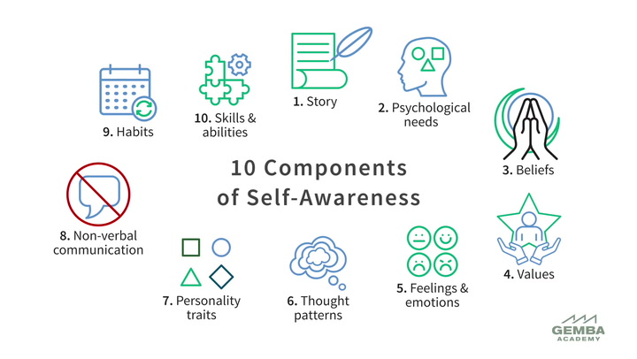
Notes:
[Inside Out link embedded]
Accurately perceive your own emotions in the moment and understand your general reactions across situations.
What is your story? About your life, personal, professional, family, relationships? Who are you?
What do you need to feel balanced and secure?
Beliefs- assumptions we make about ourselves.
Values stem from our beliefs and govern the way we behave and interact with others.
Do you have a positive outlook? Are you a glass half-empty or half-full person?
6. Growth mindset?
Example: me getting upset when hubby steps in to help unload the dishwasher when I’m already doing it. Me being aware of my thought patterns.
7. Are you open-minded? Quick to judge? Excited or scared about social gatherings? Are you witty or more serious? Values- integrity, how does that guide your decisions.
8. Do you stand with your arms crossed or have them down at your sides? *eye contact
9. Do you wake up on time and go for a walk or do a brain puzzle in the morning? Or do you hit snooze 3 times and run late?
10. Do you practice Duolingo to learn a new language? Do you like to learn? Are you more logical or hands-on with tools?
None are BAD or WRONG. Some are healthier and improve your emotional intelligence with working with others and being successful. It’s about knowing yourself!

Slide 15
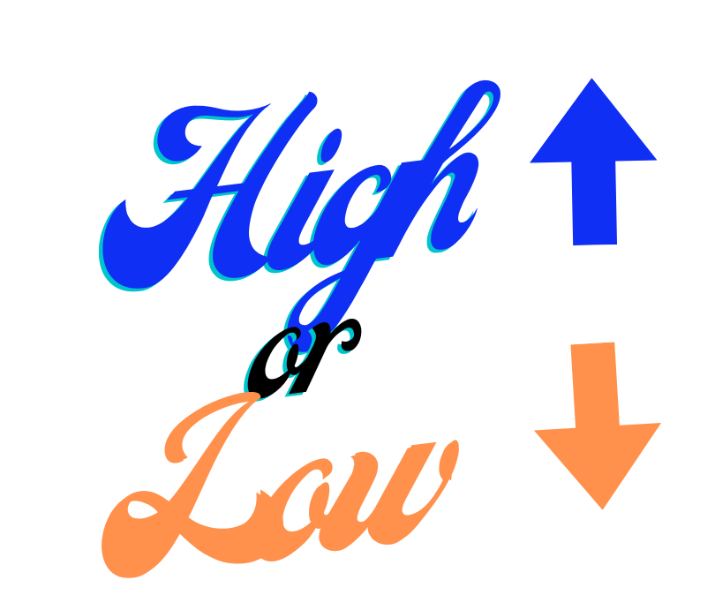
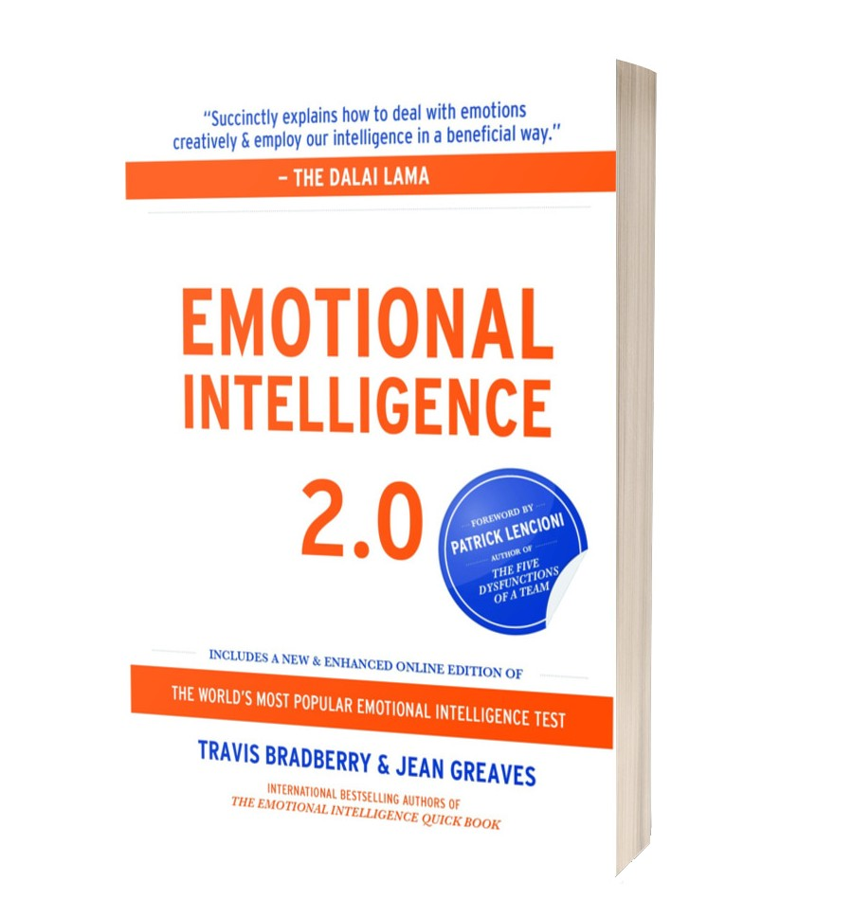
SELF-AWARENESS
“Dave has clear long-term goals, and he doesn't ‘t make sacrifices for short-term gains. Dave is an ‘up-front’ kind of guy who doesn’t play ‘mind games’ with people. I have witnessed this at company meetings and in meetings with customer.”
“In every situation that I have been involved with, good or bad, Maria has always remained calm, cool, and collected—even at times when I know she must have felt frustrated or angry. Maria is really honest about what she is feeling without getting bent out of shape about it. When faced with a difficult situation, she knows how to be firm and still kind at the same time.”
“On occasion, Tina’s stress and sense of urgency are projected/pushed on to other people. It would be good for her to better understand how her behavior affects others’ work and emotional stress.”
“Giles is passionate about what he does. Sometimes that passion gets in the way. He might not notice that I am busy with something else before he jumps in and starts talking to me. When he is excited, he talks over you, and it is hard to get a word in edgewise. He doesn’t mean to; he just is excited about what he does.”
Bradberry, T., & Greaves, J. (2009). Emotional Intelligence 2.0. TalentSmart.

Slide 16
Breakout Activity
In interviews, a question most of us dislike when asked (but is central to assigning EQ) as ‘what is your greatest weakness’ (or sometimes ‘what is your biggest flaw?’)
  In small groups, discuss how you would answer this question in an interview, and how it can be used as a read of your EQ

Slide 17
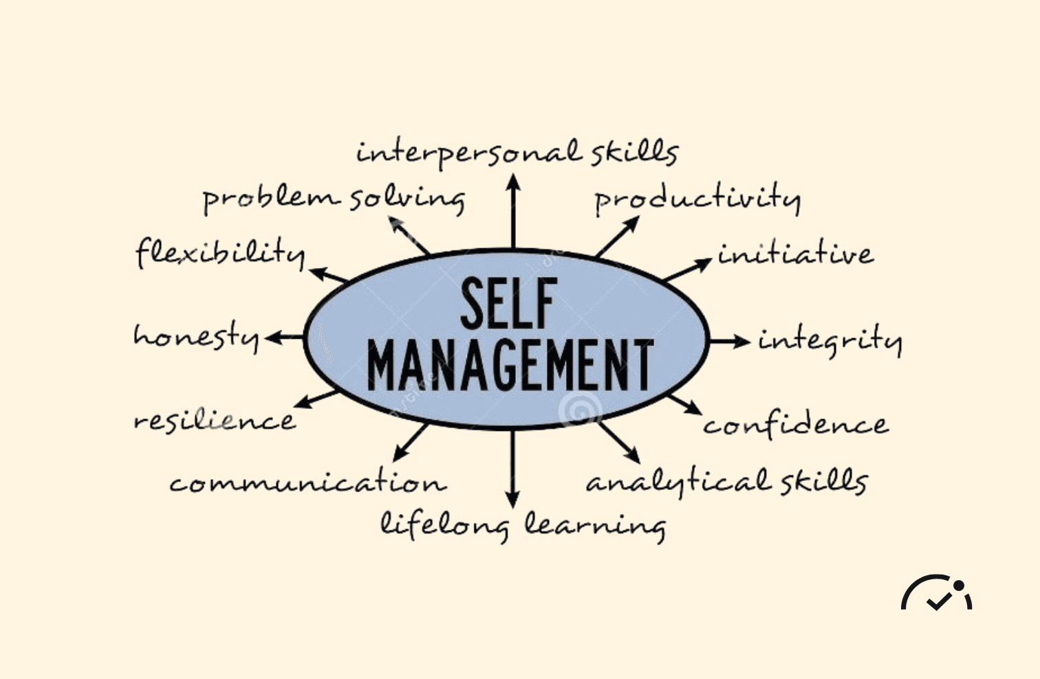
Self Management Strategies
Count to 10
Breathe right
Sleep on it
Fix your sleep patterns
Talk to a skilled self-manager
Schedule time to problem solve
Schedule time to recharge
Take control of your self-talk
Talk to an unbiased party
Accept that change is coming

Slide 18
Care of the self
These are not so much workplace or management skills, as life skills—no matter what you do, they can help you manage or care for the self

Slide 19
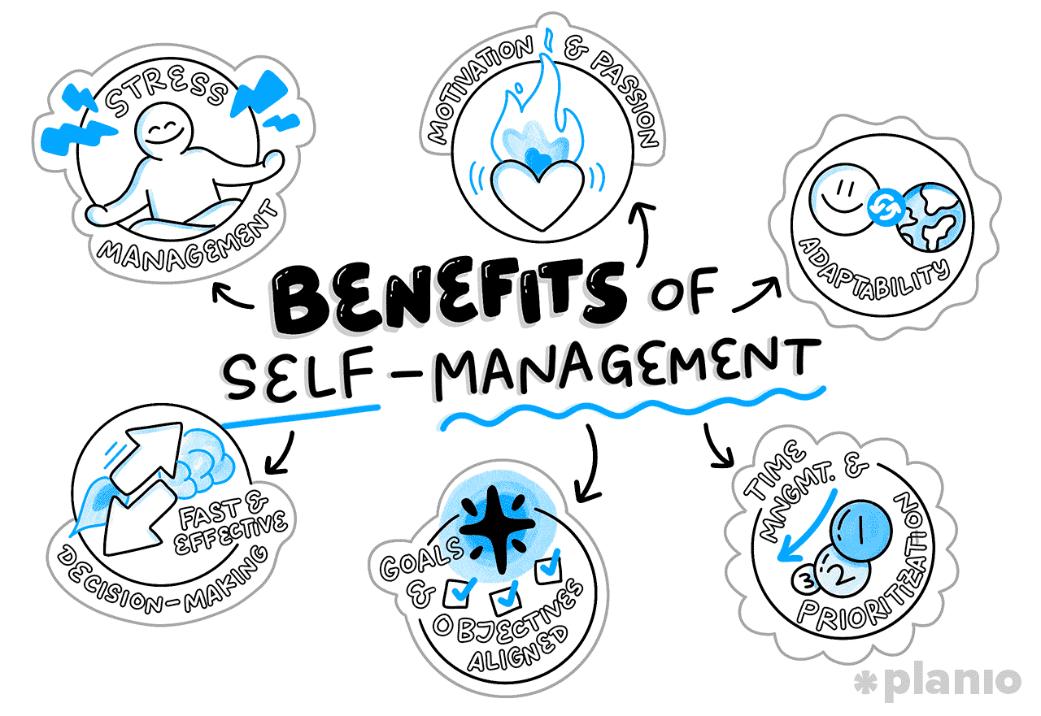

Slide 20

SOCIAL AWARENESS:
Your ability to LOOK OUTWARD to recognize and understand moods of others and groups of people .

Slide 21
The Social Awareness test: How Are You?
If someone answers, ‘fine’, they typically aren’t fine, or want to talk about a problem.
When to recognize in direct reports who needs time, and who is constantly grumbling
The quiet person desperately seeking help or approval but too terrified to ask

Slide 22
Social awareness strategies
Greet people by name
Watch body language
Remember “timing is everything”
Actively listen
Step into their shoes
Notes:
If you’re not sure how to pronounce their name, ask!
As a good leader, you need to stretch outside YOUR comfort zone. Imposter syndrome (focus on facts, learning from team members, be present)- yours and theirs
Don’t talk to someone when you’re angry or they seem to be busy (“I’d love to chat later when you have a minute.”
Two ears, one mouth
You never know what someone else is going through. Doesn’t mean that emotions or actions they’re showing are right, but as a good leader, you need to step up (and maybe away)

Slide 23
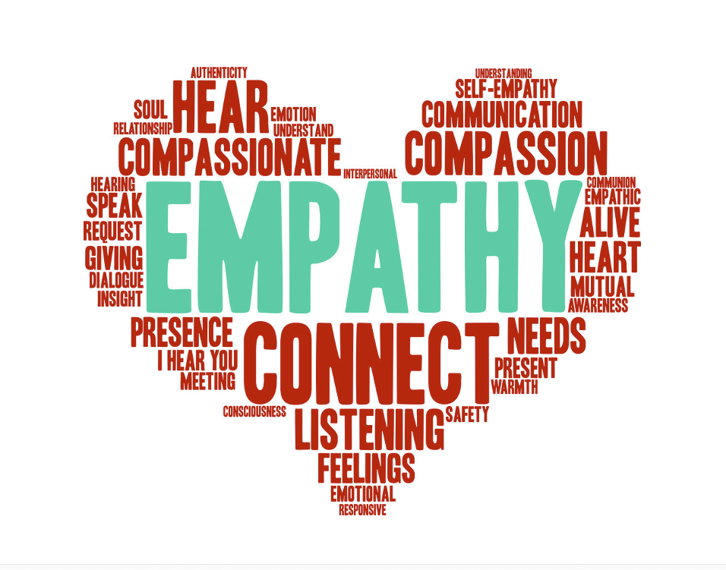
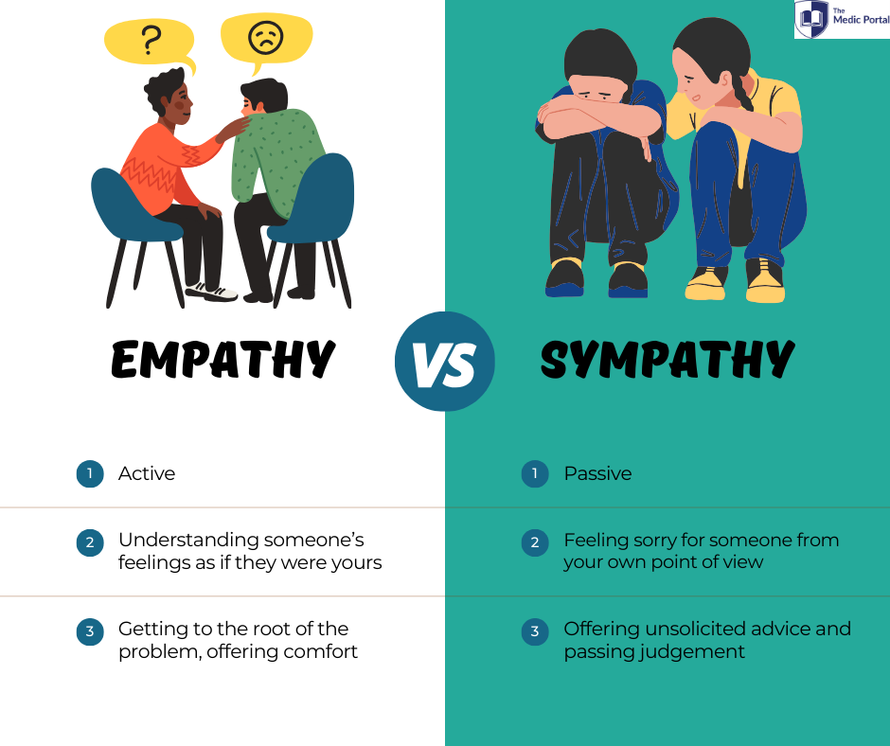

Slide 24
Empathy and Sympathy
Sympathy refuses to stand outside of oneself—can quickly turn to judgment
  “I feel sorry that their spouse died, but you can’t just not come to work”
  “They need to figure it out, we have mental health services in the benefits package, I can’t parent them back to work”
Empathy on the other hand, puts us in the living space of the other person
  Oftentimes uncomfortable, full of non-understanding
  Feeling with

Slide 25
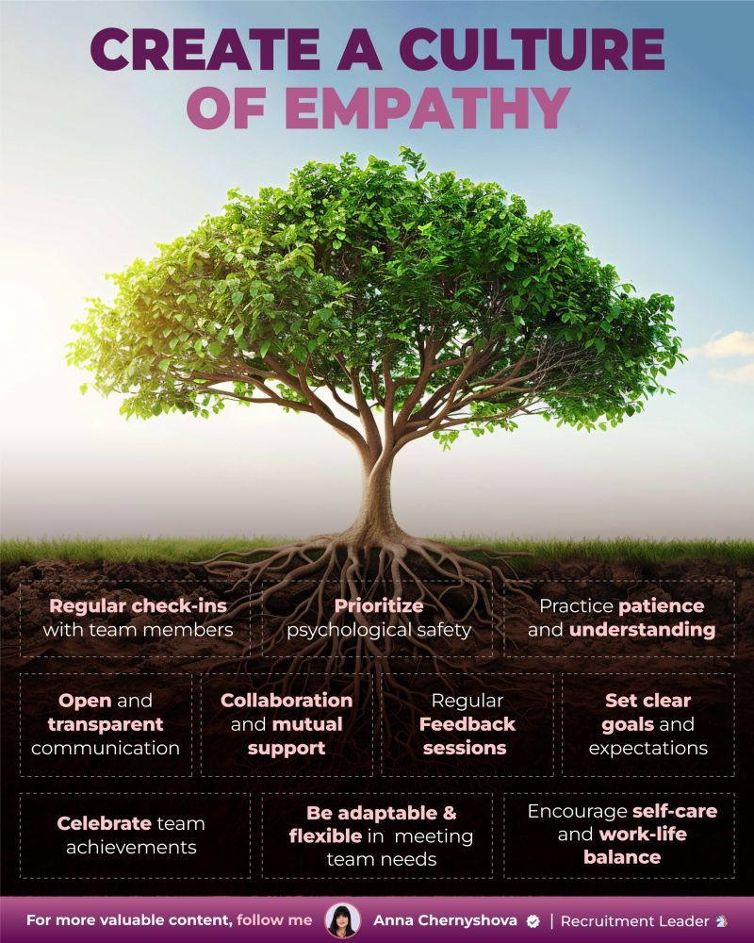
6 Simple Ways to Show Empathy
1. Ask “How can I help?”
I can see that you’re going through a tough time. How can I help?
2. Say “Thank you” more
I appreciated your ideas in the meeting. Thank you.
3. Check in often
I know things have been busy. I just wanted to check in.
4. Give space when needed
I’m going to give you some space, but I’m here if you need anything.
5. Pause before you judge
I’m not sure if I understand completely, but I’d like to.
6. Be vulnerable too
I’m having a tough morning. I appreciate your patience with me.
Notes:
Some other

Slide 26
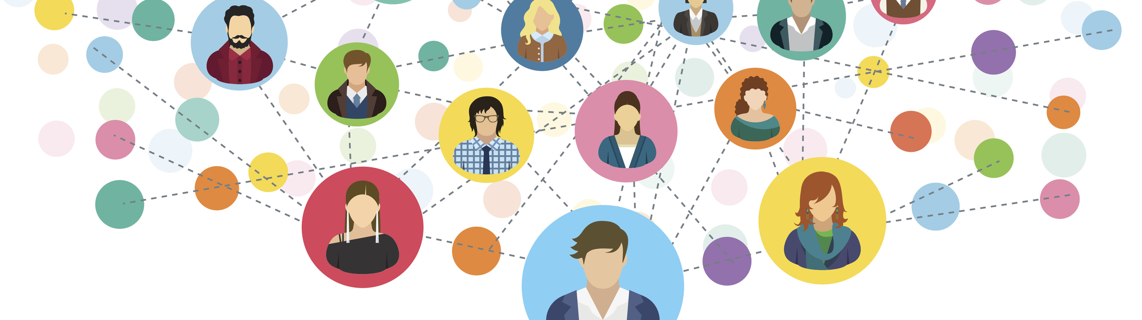
Relationship Mgmt
Your ability to use your understanding of emotions – both your own and others' – to build and maintain healthy relationships, handle conflict, and collaborate effectively.

Slide 27

Banking EQ
First time investors or homebuyers putting down life savings or large chunks of money on something
  DON’T: lots of people have done this, there’s a deadline, minimizing frustrations
  DO: common to have anxiety, fears; talk them through it; treat them like a person, not just a client
  Internally, supporting colleagues

Slide 28
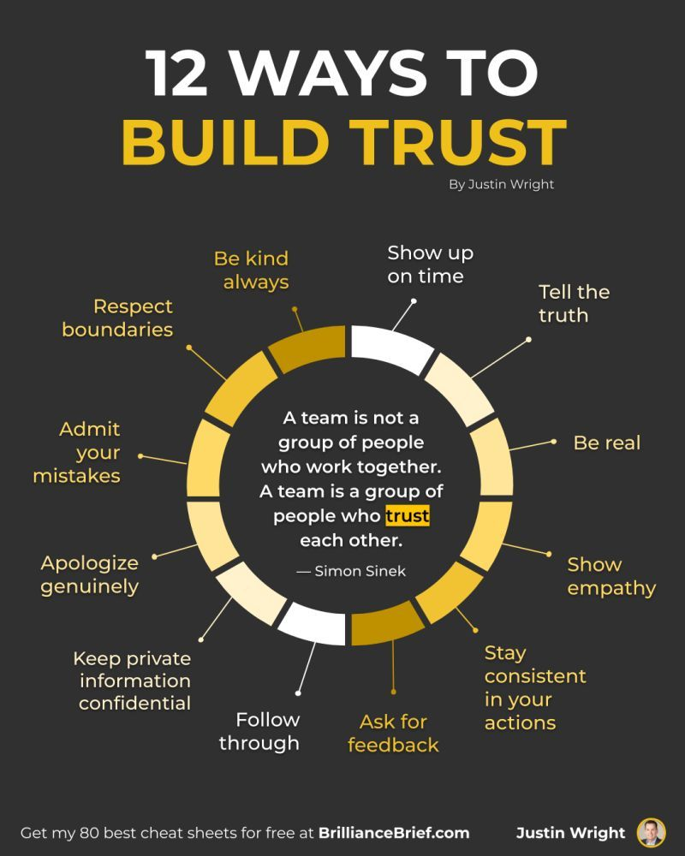
Additional Strategies for Great Leaders
Have an “open door” policy
When you care, show it
Explain your decisions
Tackle a tough conversation
Take feedback well

Slide 29
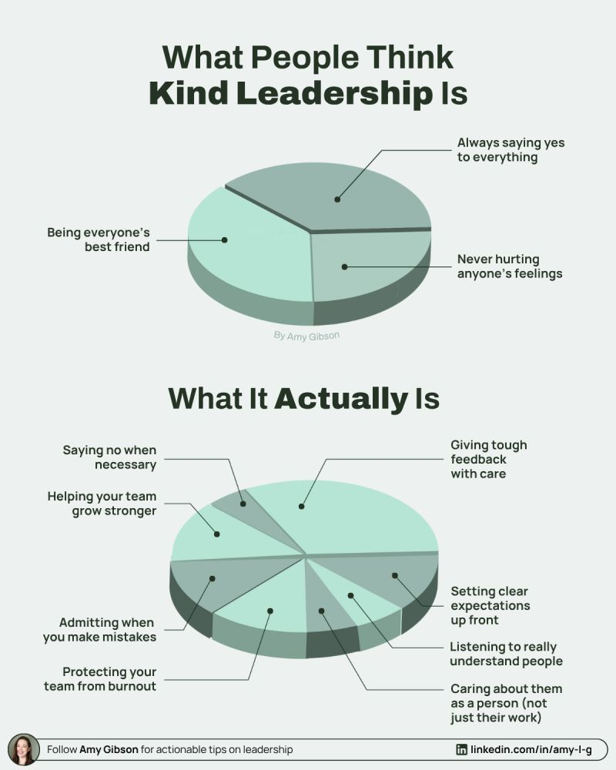

Slide 30
Kind vs nice
Midwestern “nice”: initially warm, accommodating, will cross the street to welcome you to the neighborhood
East Coast “Kind”: will ignore you when you move in, mind their business, but if your house is burning down will help rescue a cat or a vase
BOTH work as leadership styles, both have drawbacks

Slide 31
Breakout
Which aspects of emotional intelligence do you believe are the most important?
Which would you choose to prioritize in your career?

Slide 32


Slide 33
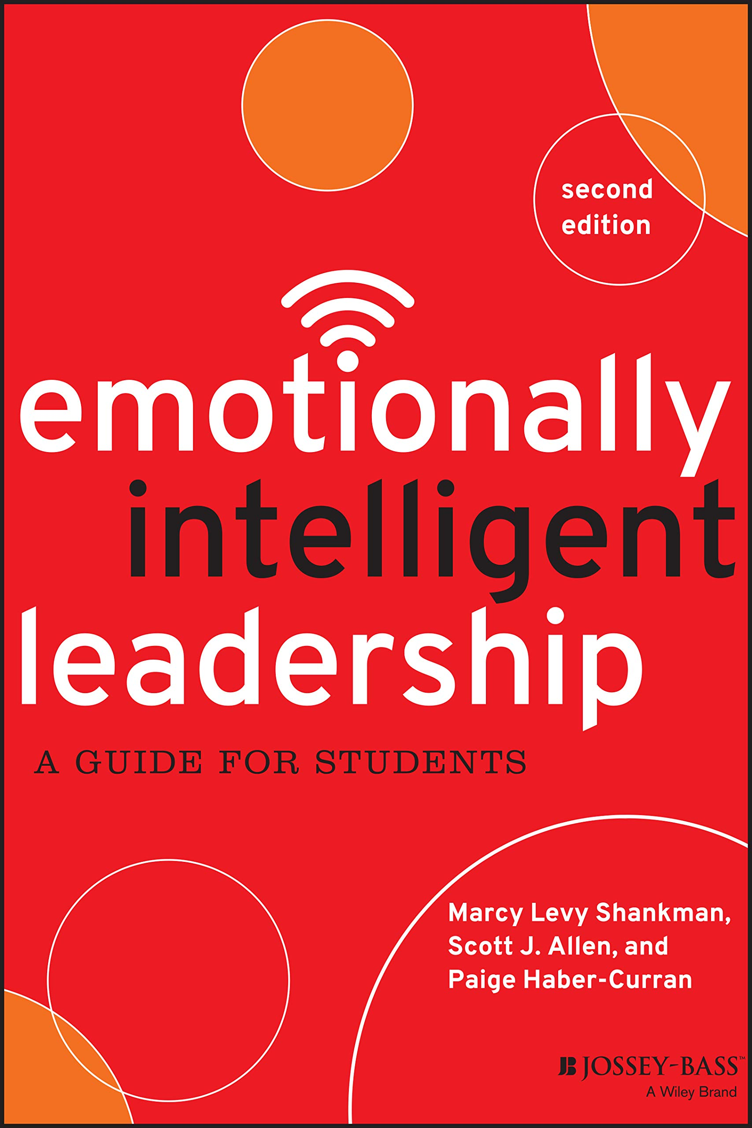
Emotionally intelligent leadership
Consciousness of:
Self
Others
Context
INTENTIONAL FOCUS
through 19 “capacities” (skills)
to achieve desired
LEADERSHIP OUTCOMES
Notes:
Across the three EIL facets are nineteen capacities that equip individuals with the knowledge, skills, perspectives, and attitudes to achieve desired leadership outcomes
three key facets of EIL: consciousness of self (understanding one's own emotions and how they impact behavior), consciousness of others (empathy and understanding the emotions and motivations of others), and consciousness of context (understanding the situation and environment).
EVERYONE has the capacity to be a leader!! Not just in a formal business environment, but in all your areas of college life. Student club, athletic team, classroom, campus job.

Slide 34
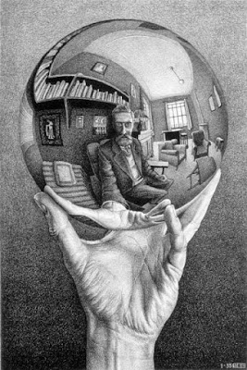
Capacities of SELF
Emotional self-perception
Emotional self-control
Authenticity
Healthy self-esteem
Flexibility
Optimism
Initiative
Achievement
Notes:
Emotional Self-Perception: Identifying emotions and their influence on behavior. Emotional self-perception is about describing, naming, and understanding your emotions. Emotionally intelligent leaders are aware of how situations influence emotions and how emotions affect interactions with others.
Emotional Self-Control: Consciously moderating emotions. Emotional self-control means intentionally managing your emotions and understanding how and when to demonstrate them appropriately. Emotionally intelligent leaders take responsibility for regulating their emotions and are not victims of them.
Authenticity: Being transparent and trustworthy. Authenticity is about developing credibility, being transparent, and aligning words with actions. Emotionally intelligent leaders live their values and present themselves and their motives in an open and honest manner.
Healthy Self-Esteem: Having a balanced sense of self. Healthy self-esteem is about balancing confidence in your abilities with humility. Emotionally intelligent leaders are resilient and remain confident when faced with setbacks and challenges.
Flexibility: Being open and adaptive to change. Flexibility is about adapting your approach and style based on changing circumstances. Emotionally intelligent leaders seek input and feedback from others and adjust accordingly.
Optimism: Having a positive outlook. Optimism is about setting a positive tone for the future. Emotionally intelligent leaders use optimism to foster hope and generate energy.
Initiative: Taking action. Initiative means being a self-starter and being motivated to take the first step. Emotionally intelligent leaders are ready to take action, demonstrate interest, and capitalize on opportunities.
Achievement: Striving for excellence. Achievement is about setting high personal standards and getting results. Emotionally intelligent leaders strive to improve and are motivated by an internal drive to succeed.

Slide 35

Capacities of OTHERS
Displaying empathy
Inspiring others
Coaching others
Capitalizing on difference
Developing relationships
Building teams
Demonstrating citizenship
Managing conflict
Facilitating change
Notes:
Displaying Empathy: Being emotionally in tune with others. Empathy is about perceiving and addressing the emotions of others. Emotionally intelligent leaders place a high value on the feelings of others and respond to their emotional cues.
Inspiring Others: Energizing individuals and groups. Inspiration occurs when people are excited about a better future. Emotionally intelligent leaders foster feelings of enthusiasm and commitment to the organizational mission, vision, and goals.
Coaching Others: Enhancing the skills and abilities of others. Coaching is about helping others enhance their skills, talents, and abilities. Emotionally intelligent leaders know they cannot do everything themselves and create opportunities for others to develop.
Capitalizing on Difference: Benefitting from multiple perspectives. Capitalizing on difference means recognizing that our unique identities, perspectives, and experiences are assets, not barriers. Emotionally intelligent leaders appreciate and use difference as an opportunity to create a broader perspective.
Developing Relationships: Building a network of trusting relationships. Developing relationships means creating meaningful connections. Emotionally intelligent leaders encourage opportunities for relationships to grow and develop.
Building Teams: Working with others to accomplish a shared purpose. Building teams is about effectively communicating, creating a shared purpose, and clarifying roles to get results. Emotionally intelligent leaders foster group cohesion and develop a sense of “we.”
Demonstrating Citizenship: Fulfilling responsibilities to the group. Citizenship is about being actively engaged and following through on your commitments. Emotionally intelligent leaders meet their ethical and moral obligations for the benefit of others and the larger purpose.
Managing Conflict: Identifying and resolving conflict. Managing conflict is about working through differences to facilitate the group process. Emotionally intelligent leaders skillfully and confidently address conflicts to find the best solution.
Facilitating Change: Working toward new directions. Facilitating change is about advancing ideas and initiatives through innovation and creativity. Emotionally intelligent leaders seek to improve on the status quo and mobilize others toward a better future.

Slide 36
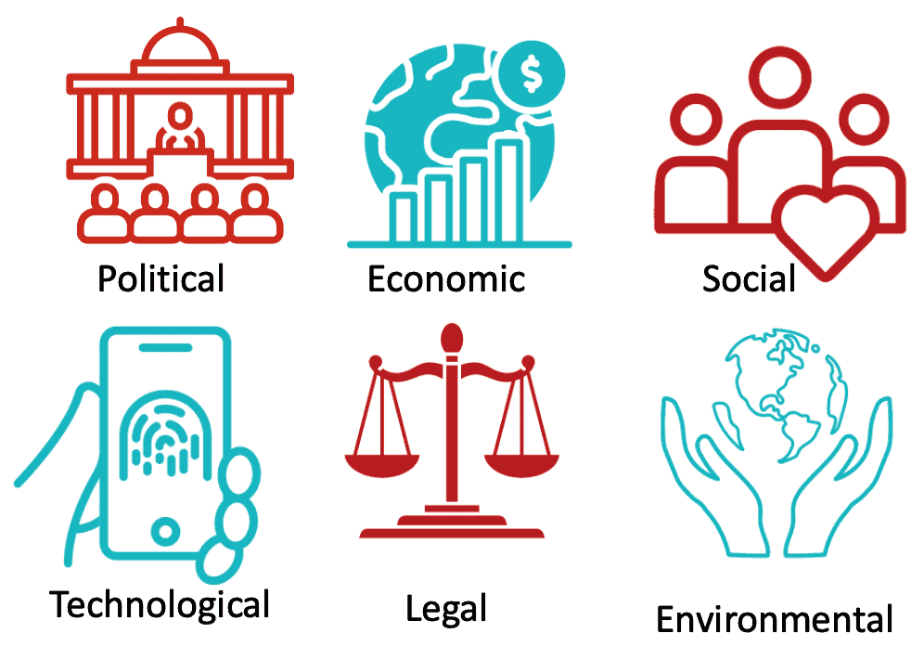

Capacities of CONTEXT
18. Analyzing the group
19. Assessing the environment
Notes:
Analyzing the Group: Interpreting group dynamics. Analyzing the group is about recognizing that values, rules, rituals, and internal politics play a role in every group. Emotionally intelligent leaders know how to diagnose, interpret, and address these dynamics.
Assessing the Environment: Interpreting external forces and trends. Assessing the environment is about recognizing the social, cultural, economic, and political forces that influence leadership. Emotionally intelligent leaders use their awareness of the external environment to lead effectively. (tariffs, changes to financial aid policy, exchange rates or lending rates)

Slide 37
Breakout Session
OTHERS:
Displaying empathy
Inspiring others
Coaching others
Capitalizing on difference
Developing relationships
Building teams
Demonstrating citizenship
Managing conflict
Facilitating change
CONTEXT:
Analyzing the group
Assessing the environment
Which capacity would you prioritize to develop? How?
SELF:
Emotional self-perception
Emotional self-control
Authenticity
Healthy self-esteem
Flexibility
Optimism
Initiative
Achievement
Notes:
Which would you prioritize to develop? How? Can pick 2 or 3.

Slide 38
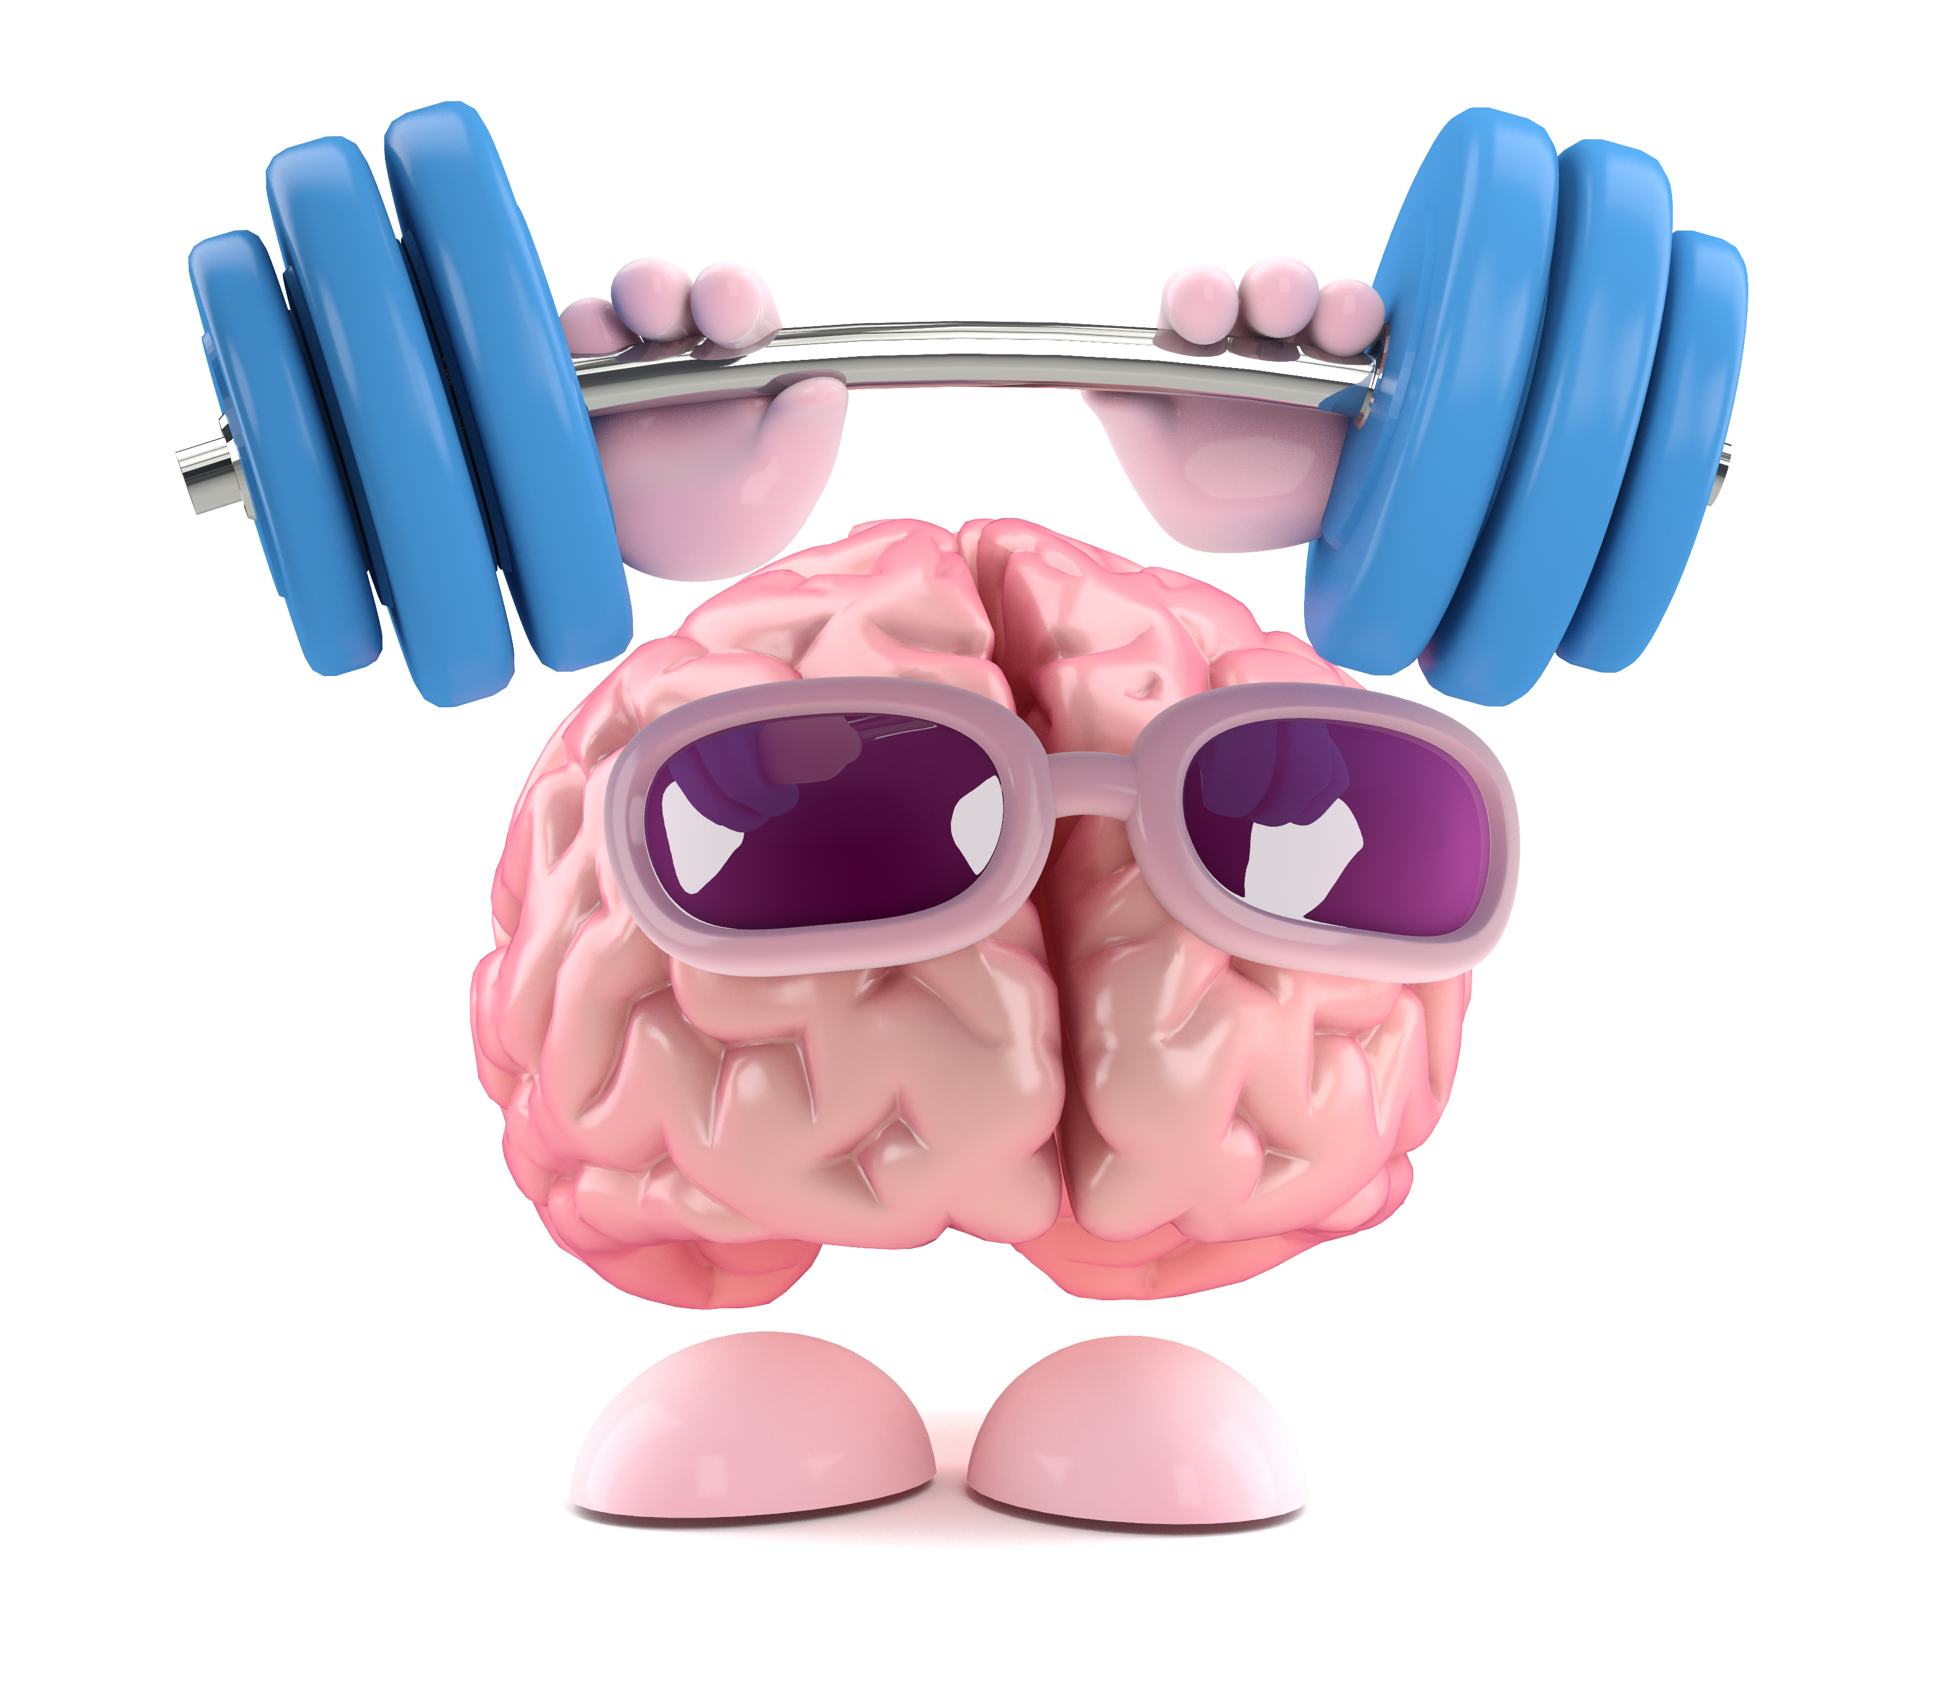
It takes work to build your EI muscle!

Slide 39
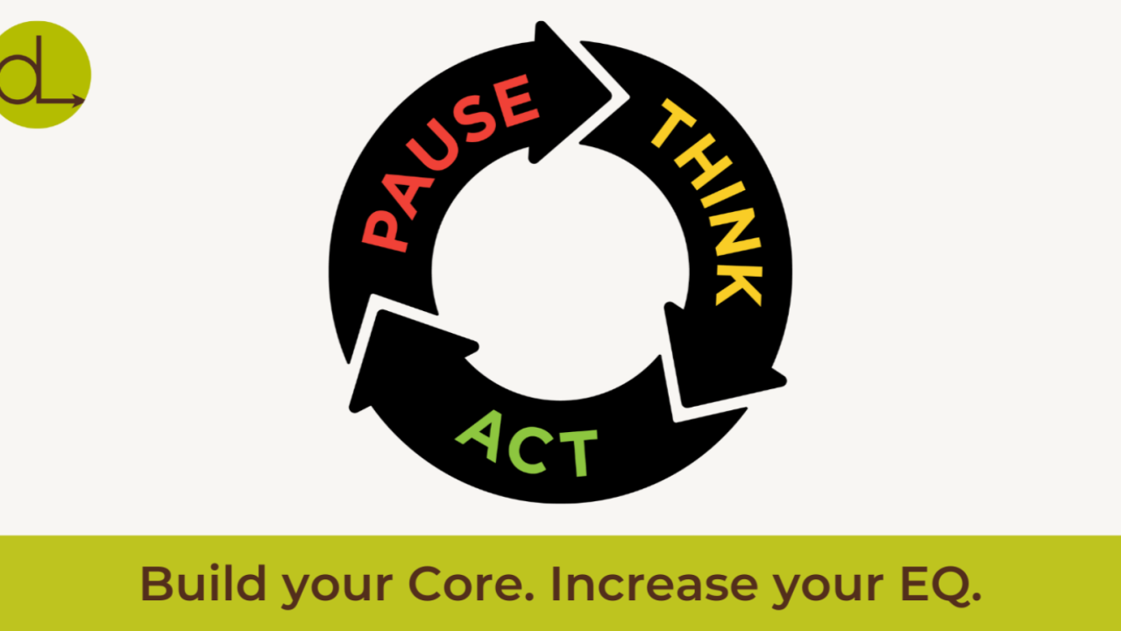

Slide 40
Emotionally intelligent leadership
Pause before reacting
Check in with your emotions daily
Ask open-ended questions
Journal your emotional triggers
Validate others’ feelings
Give regular appreciation
Set clear emotional boundaries
Notice body language clues
Learn to apologize sincerely
Celebrate small wins together

Slide 41

AI in Emotional Intelligence
The issue isn’t so much that AI, but the routine of acting like a robot (which was already an issue in workplaces!)
  Addressing problems through ‘policy’ instead of 1-on-1
  While it brings technical skills, the human skills become even more important-–can’t automate relationships
  Respect: can automate a report, but when asked for judgment, your ‘value-add’ to an analysis, …can you provide anything?

Slide 42
Ai in emotional intelligence
Managing emotions of people you hardly see face-to-face (Slack, Zoom, Remote)
Tone—AI often suggest answers that are faux-sympathetic, but strikes out on empathy

Slide 43

Have a great rest of your day!
CAREER & LEADERSHIP SKILLS ACADEMY

