Slide 1

Rachel Carson, hawk mountain & Storytelling
Dr. Robert Foschia
Comp 100

Slide 2
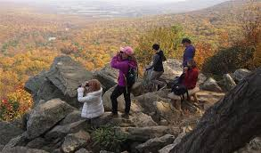

Slide 3
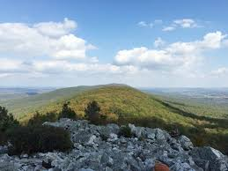

Slide 4
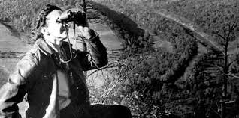
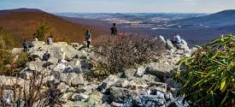
Hawk Mountain & Rachel Carson Primer
Based on the photos, write fifty words (using a mixture of description and emotive language) describing your reaction and observations of the photos
If you don’t know who Rachel Carson is, hopefully the readings/discussion today will illuminate that (don’t need it for the primer)

Slide 5
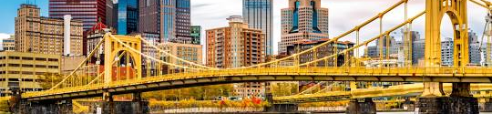
Rachel carson bridge – Pittsburgh, pa

Slide 6
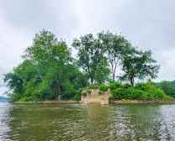
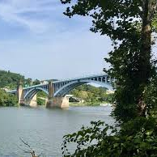
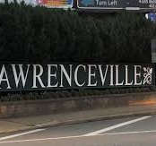
Personal Stories
The stories I’ve always been told about my hometown were of industry, blue collar work ethic, grit
These were never framed as environmental stories-–the rivers polluted by that industry; the writers who left because of that pollution; the towns that were left to it, only to be gentrified later.
The setting had an impact on me, even if I didn’t recognize it

Slide 7
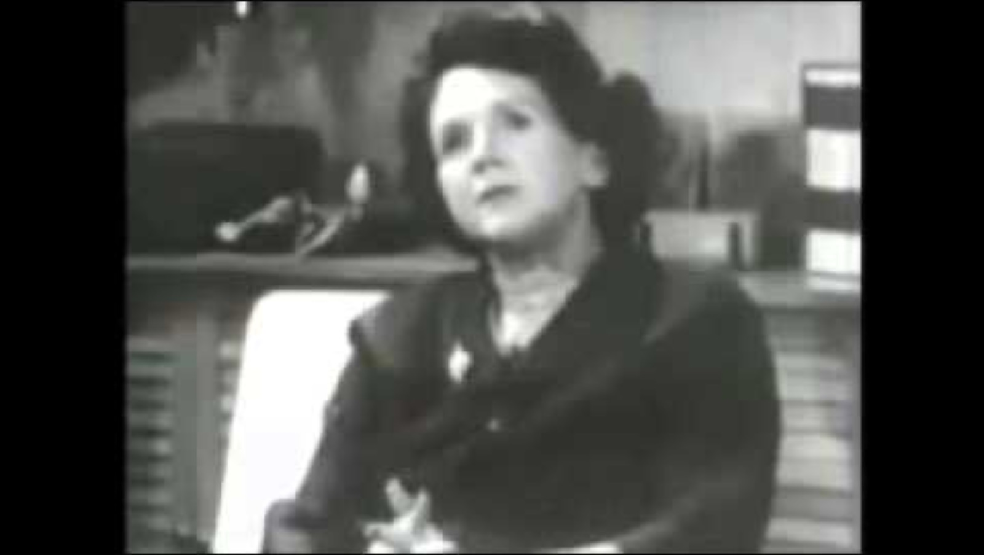
Carson’s promotional work

Slide 8
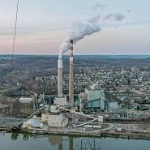
Rachel Carson
Grew up in Springdale, PA (outside of PGH)
Attended Chatham University (then PA Women’s College) changed to Biology from English
Started working with the Fish and Wildlife service
Writes Silent Spring in 1962 and ~poof~ the US environmental movement begins

Slide 9
The start of every fantasy quest
“Then a strange blight crept over the area and everything began to change. Some evil spell had settled on the community: mysterious maladies swept the flocks of chickens; the cattle and sheep sickened and died. Every where was a shadow of death. The farmers spoke of much illness among their families. In the town the doctors had become more and more puzzled by new kinds of sickness appearing among their patients. There had been several sudden and unexplained deaths, not only among adults but even among children, who would be stricken suddenly while at play and die within a few hours” (Carson, 2).

Slide 10
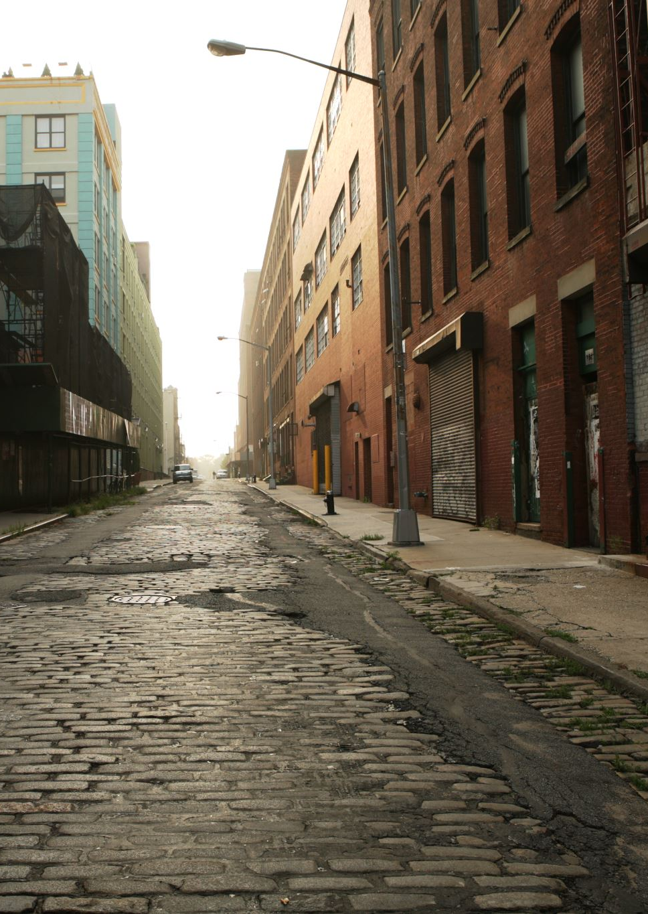
Everytown, USA
“No witchcraft, no enemy action had silenced the rebirth of new life in this stricken world. The people had done it themselves.
This town does not actually exist, but it might easily have a thousand counterparts in America or elsewhere in the world. I know of no community that has experienced all the misfortunes I describe. Yet every one of these disasters has actually happened somewhere, and many real communities have already suffered a substantial number of them. A grim specter has
crept upon us almost unnoticed, and this imagined tragedy may easily become a stark reality we all shall know. What has already silenced the voices of spring in countless towns in America? This book is an attempt to explain” (Carson, 3)

Slide 11
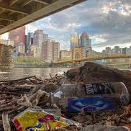
Impacts of Silent Spring
“In Silent Spring, Rachel Carson pointed out that pesticides were rapidly rolled out after World War II not because of some unmet pest-control need (like, say, farmers suddenly overrun with bugs and weeds). Rather, abundant leftover stockpiles from wartime use were in need of a domestic market. And so, with the help of Madison Avenue, one was created. DDT, a military weapon, was thus repurposed for domestic use without any premarket testing for safety. An abundance of former military planes that could be cheaply converted into spray planes—and an abundance of former military pilots who loved to fly them—helped seal the deal” (Steingarber, 2012)

Slide 12
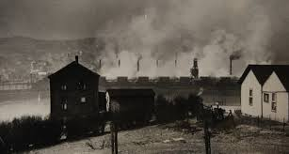
Donora, PA and the ‘Death fog’

Slide 13
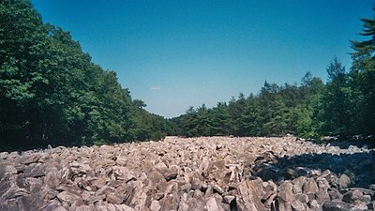
Hawk
Mountain

Slide 14
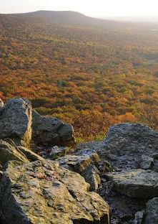
Hawk Mountain
18 miles from campus!
Originally named North Mountain in relation to South mountain (near Emmaus, PA)
One of my first trips to the Lehigh Valley I made we went to Hawk Mountain to hike with my (now) wife, during which I had no idea the Carson/PGH connection

Slide 15
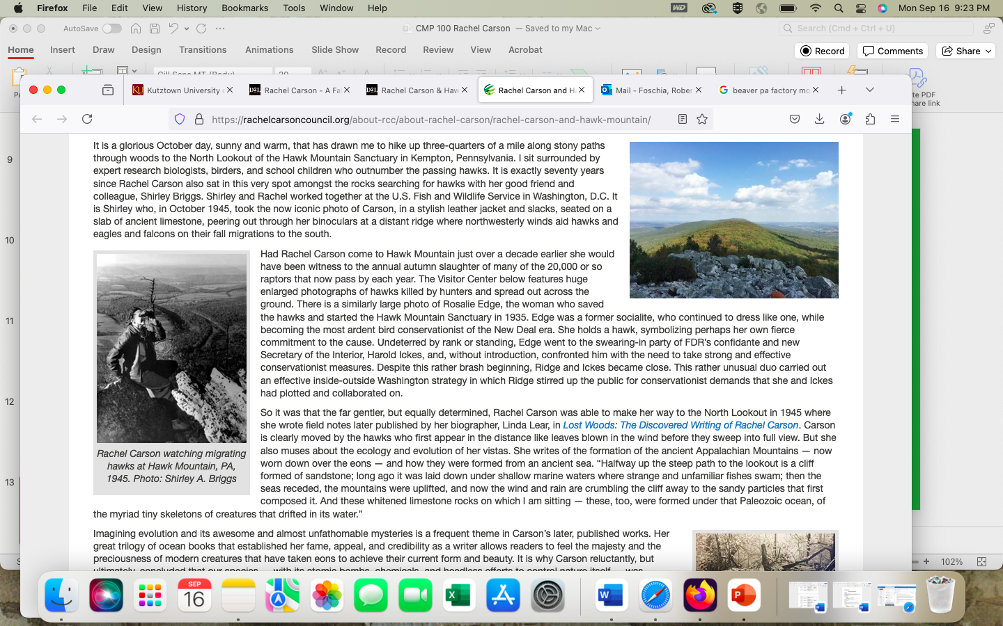
Carson @ Hawk Mountain
“It is exactly seventy years since Rachel Carson also sat in this very spot amongst the rocks searching for hawks with her good friend and colleague, Shirley Briggs. Shirley and Rachel worked together at the U.S. Fish and Wildlife Service in Washington, D.C. It is Shirley who, in October 1945, took the now iconic photo of Carson, in a stylish leather jacket and slacks, seated on a slab of ancient limestone, peering out through her binoculars at a distant ridge where northwesterly winds aid hawks and eagles and falcons on their fall migrations to the south” (Musil, ‘Carson at Hawk Mountain’)

Slide 16
(Rhetorical) Impacts
“Imagining evolution and its awesome and almost unfathomable mysteries is a frequent theme in Carson’s later, published works. Her great trilogy of ocean books that established her fame, appeal, and credibility as a writer allows readers to feel the majesty and the preciousness of modern creatures that have taken eons to achieve their current form and beauty. It is why Carson reluctantly, but ultimately, concluded that our species — with its atomic bombs, chemicals, and heedless efforts to control nature itself — was becoming dangerous” (Musil, ‘Carson at Hawk Mountain’)

Slide 17
(Rhetorical) Impacts NOW
“But Rachel Carson also believed that teaching children a “sense of wonder” for all of creation could temper our impulse to control and to destroy. She would have welcomed the middle school students I saw clambering easily over the rocks, squealing with delight as even a lowly Turkey Vulture glides by on the wind”
“Black vultures did not arrive to be counted at the North Lookout until the 1990s – some twenty years ago. Now dozens of them nest nearby. It is the gradual warming of our climate by burning fossil fuels that has steadily moved these once southern birds to Pennsylvania” (Musil, ‘Carson at Hawk Mountain’)

Slide 18
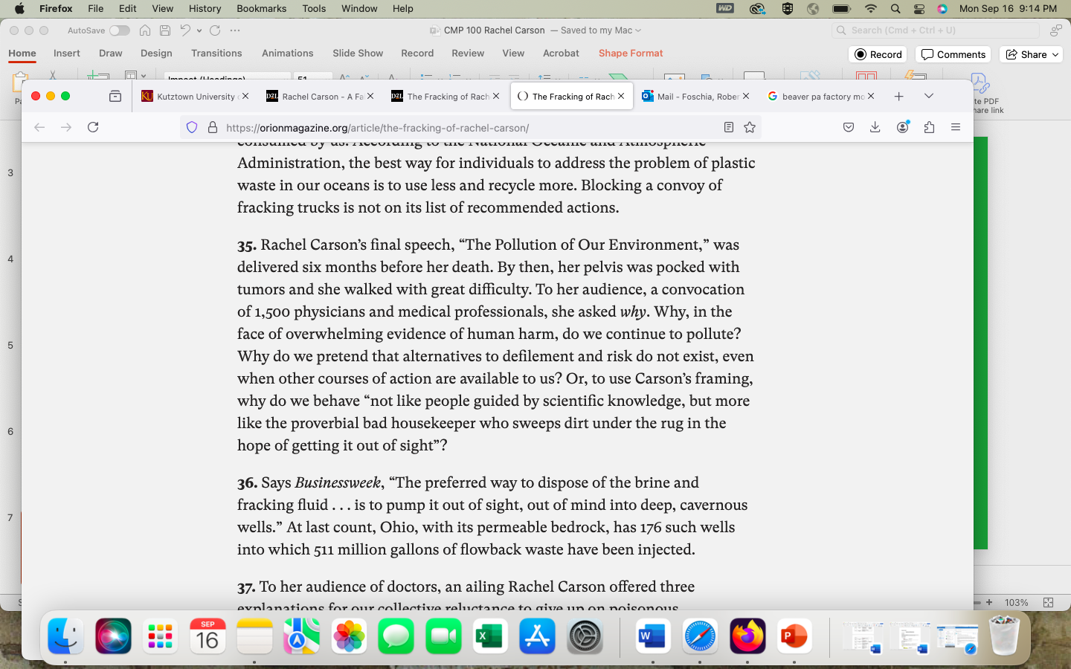
Different frames, different stories
The “Fracking of Rachel Carson” piece is more investigative journalism, it adds an empathetic layer onto the photo.
Does the emotive charge of that piece change your reaction to the photo? Knowing that Carson hated sitting for photos but did so for a cause, that this was (seemingly) an authentic moment?

Slide 19
The ‘why’ (Or my why)
I can easily show you a picture of Hawk Mountain, and it might look pretty, but it is not invested with any of the significance of this cross-state hopping around.
01
The place is also deeply tied to the environmental movement, to the legacy of Carson, not only as a person, but her specific mode of questioning and support for the environment.
02
It holds a lot of personal importance for me both personally and professionally—this tie from one locality to another, as well as this professional niche
03

Slide 20
Shell Plant, Monaca pA
“Carson painstakingly pieced together the evidence available to her—reports of farmers with bone marrow degeneration, sheep with nasal tumors, spray-gun-toting housewives with leukemia—and concluded that cancer was striking the general population with increasing frequency. She believed that she was seeing the early signs of an epidemic in slow motion. She was especially concerned with the apparent rise in cancers among children. And she was right” (Steingarber, 2012)

Slide 21
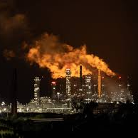
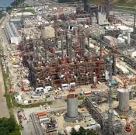
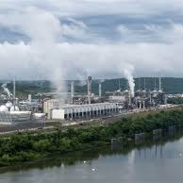
Shell Plant, Monaca pA

Slide 22
Why Pollute?
We wait too long to evaluate risk, and technologies become embedded
Nature has its own ways of absorbing, remixing, and reacting to pollutants (that we cannot predict or control)
We act as if we are not animals

Slide 23
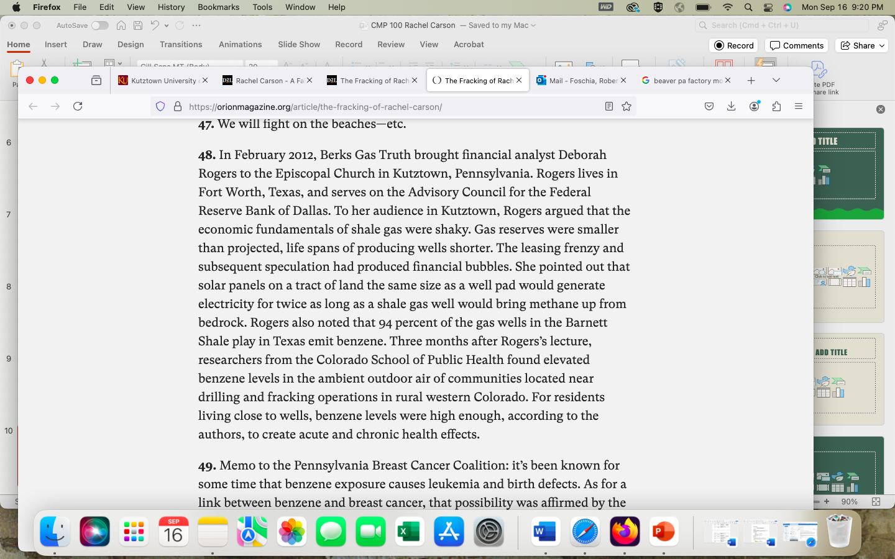
What does this do to the story?
Take out your fifty words on Hawk Mountain photos. Has your opinion changed?
Write another fifty words, this time with the knowledge of Carson suffering from breast cancer, of the history of shooting raptors there, and the efforts to make a conservationist preserve.
Read these words to your partner—what has shifted? Tone? Language? The message itself?

Slide 24
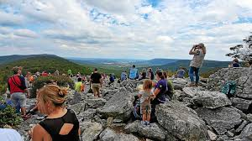
Leaving the mountain
After comparing, write another final fifty words on /place/. How has the concept of place changed over the course of the class?
Is any place hold a singular meaning for you? Why or why not? Do places change based on our interaction with them?
What are the challenges in describing places that hold so much history, so much emotive power, in descriptive language?

Slide 25
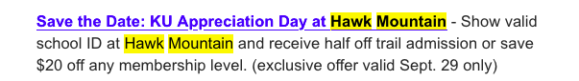
Last Plug for hawk mountain

